Slide 1
Financing, Resource Tracking & Affordability Module

Slide 2
Course Outline
Immunization Fundamentals
  Why financing matters
Sources of Financing
  Understanding financing systems
  Sources of financing, benefits & limitations
Understand Financing Data Systems and Locating Relevant Sources of Immunization Financing
  How to Achieve Universal Health Care Coverage
  Working with Insurance and State Mandates and Avoiding Duplicate Effort
  Resource tracking
How to Use Financial Analysis for Policy Change
  How To Be A Good Policy Change Advocate
  Planning and Budget Cycle

Slide 3
Required Readings
Results for Development (R4D). Immunization financing: a resource guide for advocates, policymakers, and program managers. Washington D.C.: R4D; 2017

Slide 4
Section A
Immunization Fundamentals

Slide 5
Section A - Immunization Fundamentals
Learning Objectives
Why immunization financing matters
Link between Universal Health Coverage and immunization financing
What are the cost components of immunization programs
Vaccine finance decision-making

Slide 6
Section A1
Why Immunization Financing?

Slide 7
Rationale for public financing?
Economic Rationale
Vaccine demand without public subsidies is too low for everyone
  Under-consumption of vaccines will not provide herd immunity, which is needed to drive diseases out of populations.
  Need herd immunity for full protection
    Measles example: need 95% coverage to prevent outbreaks
Epidemiological Rationale
Vaccines are good
Next few slides describe why vaccines are good
  But, there are many good things that don’t need public financing
    Exercise, pets, vegetables, shoes
The economic rationale goes beyond vaccine benefits
Notes:
Training in “economic argument” . Most participants have mastered the “vaccine benefits” litany. We need to cover that, but instructor has to challenge the class to go beyond the “benefits” rationale to the economic rationale so that participants can be effective in making the case in an economic choice setting.

Slide 8
Vaccines are good for countries
Vaccines save money
Vaccines save lives

Slide 9
Vaccine Benefits
Vaccines prevent illness, disability, death
  Vaccine-preventable diseases include
    cervical cancer, diphtheria, hepatitis B, measles, mumps, pertussis pneumonia, polio, rotavirus diarrhoea, rubella and tetanus.
    2 million lives saved every year
Preventable sickness costs the health system
  Rising health care coverage implies risking costs
Source: WHO 2018 Newsroom, Immunization Coverage, https://www.who.int/news-room/fact-sheets/detail/immunization-coverage
Notes:
Source: World Health Organization. Immunization coverage. January 2018. Accessed March, 2018
Source: Results for Development (R4D). Immunization financing: a resource guide for advocates, policymakers, and program managers. Washington D.C.: R4D; 2017.

Slide 10
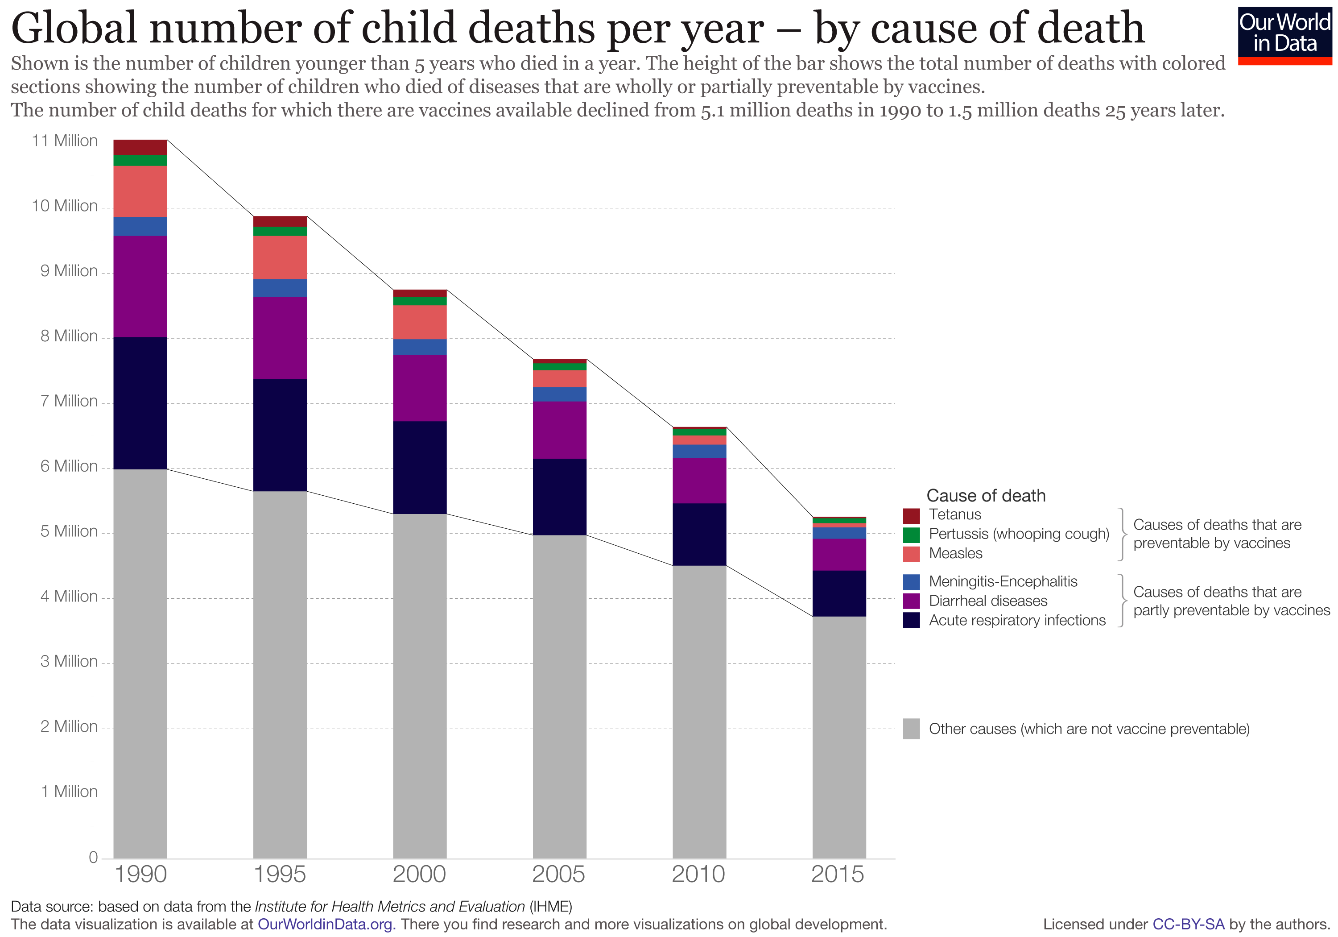
Source: https://ourworldindata.org/vaccine-preventable-diseases
Notes:
Leading Causes of Deaths in Children Under Five Years
2016 Data
Neonatal causes
Pneumonia
Other (unspecified) conditions
Congenital anomalies & other non-communicable diseases
Diarrhea
Injury
Malaria
Prematurity
HIV/AIDS
Measles
*For quick view of data on worldwide disease incidence of vaccine-preventable disease, see https://www.chop.edu/centers-programs/vaccine-education-center/global-immunization/diseases-and-vaccines-world-view. March 28, 2018.

Slide 11
Immunization’s Success Story
Track record of declining vaccine preventable disease and death
Success paradox
  When bad things don’t happen urgency recedes
  When financing falters bad things happen again

Slide 12
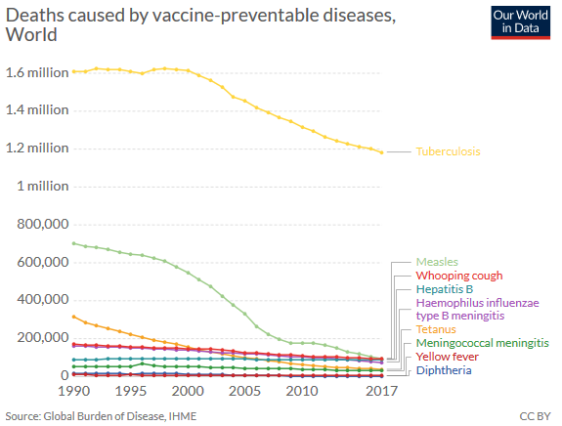
Source and link to view interactive graph: https://ourworldindata.org/vaccine-preventable-diseases

Slide 13
Scope of Immunization Continues to Grow
Global immunization coverage target is 90%
  1 in 10 infants worldwide did not receive any vaccinations in 2016
  Full course of routine immunizations stalled at 86% since 2010
Persistent and emerging diseases
  1st malaria vaccine approved in 2015, a dengue vaccine licensed in several countries, Ebola vaccine showing promise, Zika vaccine under development, etc.
Uptake of new and underused vaccines is increasing
  Global coverage of more recently-recommended vaccines are yet to reach 50% (e.g. rotavirus, pneumonia)
Source: WHO 2018 Newsroom, Immunization Coverage, https://www.who.int/news-room/fact-sheets/detail/immunization-coverage
Notes:
Vaccines against major killers of children such as rotavirus, a disease that causes severe childhood diarrhoea, and pneumonia

Slide 14
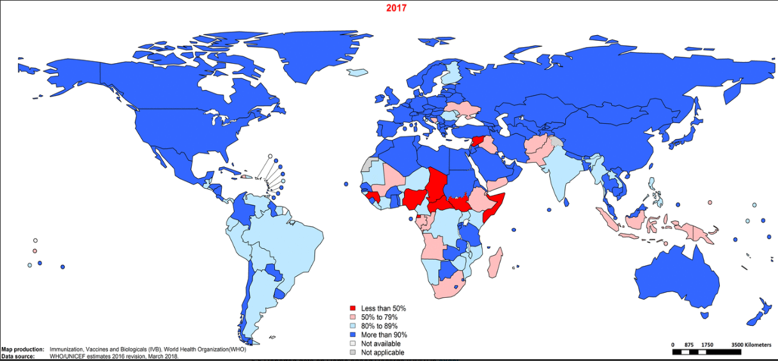
Immunization Coverage
Notes:
Source link: Immunization, Vaccines and Biologicals. Data, statistics and graphics. https://www.who.int/immunization/monitoring_surveillance/data/en/
Other sources: 2018 Global Summary found in the Global immunization profile: https://www.who.int/immunization/monitoring_surveillance/data/gs_gloprofile.pdf?ua=1

Slide 15
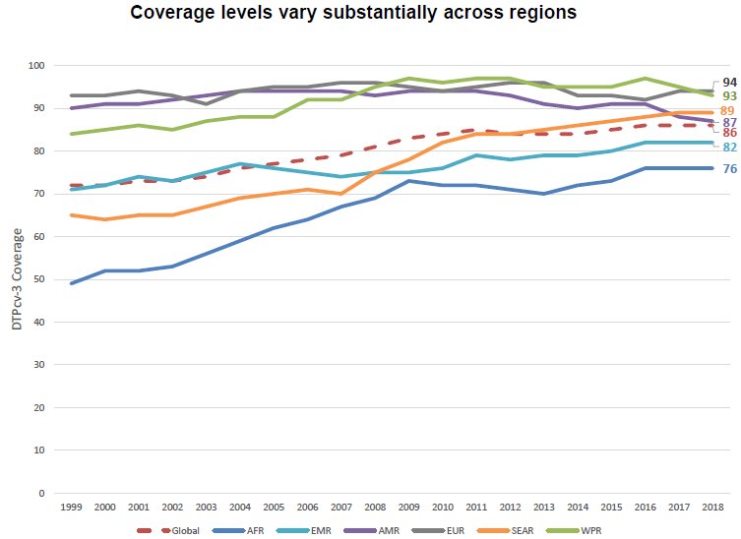
The biggest gains have been made by the African Region (over a 20 year period), and the South East Asian Region (over a ten year period).
Source: WHO and UNICEF. Progress and Challenges with Achieving Universal Immunization Coverage: 2018 WHO/UNICEF Estimates of National Immunization Coverage. (Data as of July 2019). https://www.who.int/immunization/monitoring_surveillance/who-immuniz.pdf?ua=1
Notes:
Pertussis (DTPcv-3)
Source: WHO and UNICEF. Progress and Challenges with Achieving Universal Immunization Coverage:
2018 WHO/UNICEF Estimates of National Immunization Coverage. (Data as of July 2019). https://www.who.int/immunization/monitoring_surveillance/who-immuniz.pdf?ua=1

Slide 16
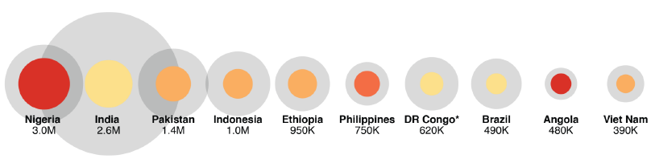

Countries with most unprotected
(under and un vaccinated) children
Just 10 countries account for 60% of unprotected children (11.7 of the 19.4 million))
* Preliminary survey suggests lower coverage and higher number of unvaccinated
Source: WHO and UNICEF. Progress and Challenges with Achieving Universal Immunization Coverage: 2018 WHO/UNICEF Estimates of National Immunization Coverage. (Data as of July 2019). https://www.who.int/immunization/monitoring_surveillance/who-immuniz.pdf?ua=1

Slide 17
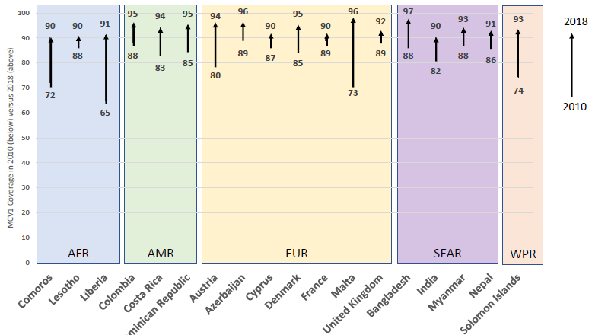
Coverage with a first dose of measles containing vaccine
Between 2010 and 2018, 18 additional countries improved MCV1 coverage to at least 90%
Source: WHO and UNICEF. Progress and Challenges with Achieving Universal Immunization Coverage: 2018 WHO/UNICEF Estimates of National Immunization Coverage. (Data as of July 2019). https://www.who.int/immunization/monitoring_surveillance/who-immuniz.pdf?ua=1
Notes:
Positive change

Slide 18
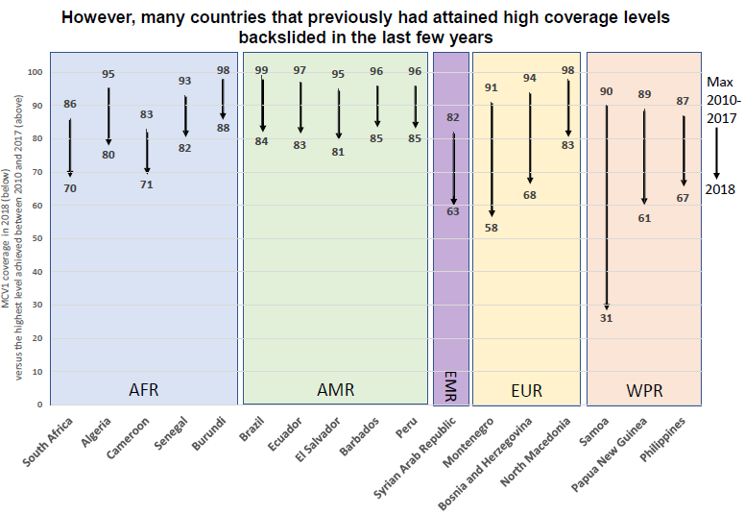

Slide 19
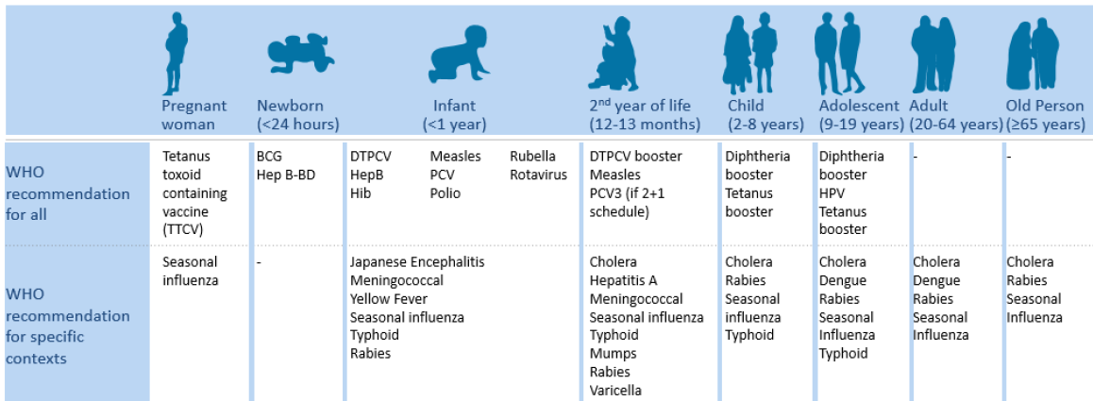
Immunization opportunities throughout the life course
A complete WHO immunization recommendations can be found in the Vaccine Position Papers and Summary Tables available at www.who.int/immunizaiton/policy/en/

Slide 20
The Value of Immunization
Among the most cost-effective health interventions
  Delivers a high ratio of health benefits (lives saved and illness prevented) to cost
  Benefits translated into economic terms
    Treatment costs
    Productivity lost to illness and caretaking
    Years of earnings lost to premature death & disability
    Herd immunity
    Long-term development dividend
  Exceptionally good investment → Best uses of limited public funds for health
  Per every 1 dollar spent (on expanding access to a portfolio of vaccines in low- and middle-income countries between 2011-2020) would return $16 in economic benefits*
Sources: *Ozawa S, et al. (2016) and Masia et al. (2018)
Notes:
*Estimate excludes benefits of herd immunity & development dividend
Source: Results for Development (R4D). Immunization financing: a resource guide for advocates, policymakers, and program managers. Washington D.C.: R4D; 2017.
Source: Ozawa S, Clark S, Portnoy A, Grewal S, Brenzel L, Walker DG. Return on investment from childhood immunization in low- and
middle-income countries, 2011–20. Health Aff. 2016 Feb 1;35(2):199-207.
herd immunity (the protection that high levels of immunization in a population can provide even to unvaccinated people)
Long-term development dividend (i.e., healthier children and increased school attendance)(

Slide 21
The Value of Immunization
Virtue of immunization → Equity
Benefits reach the poor to a greater extent than most other health interventions
  Poor people bear a disproportionate burden
  Poorest children are immunized at lower rates than better-off children, but the disparity is typically much less pronounced than for other health interventions in developing countries
  Girls are immunized at the same rates as boys
  Heightened focus on equity in the 2015–2030 UN Sustainable Development Goals
  Another argument for investment in immunization
Results for Development (R4D). Immunization financing: a resource guide for advocates, policymakers, and program managers. Washington D.C.: R4D; 2017.
Notes:
Sources: International Vaccine Access Center [forthcoming]. Value of Immunization Compendium of Evidence (VoICE) tool.
Available from: http://view-hub.org/ ????????????????? Outdated????????????????
herd immunity (the protection that high levels of immunization in a population can provide even to unvaccinated people)
Long-term development dividend (i.e., healthier children and increased school attendance)(

Slide 22
Why is it Important for Governments to Finance Immunization Programs?
Immunization programs require public resources
  Coordinating activities at the national level
  Vaccine procurement and supply chains
  Financing of the primary care facilities and staff to deliver routine immunization
Herd immunity is a public good
  Social benefit exceeds the value to individuals
Access to immunization is widely seen as a right
  SDG indicator 3.b.1 (% covered by all vaccines)
  SDG indicator 3.8.1 (Included in Universal Health Coverage indicator)
Results for Development (R4D). Immunization financing: a resource guide for advocates, policymakers, and program managers. Washington D.C.: R4D; 2017.
Notes:
Classic example of a “public good” whose social benefit exceeds the value to individuals or households. Social benefit - control of infectious diseases and herd immunity
Continued indefinitely: except in exceptional cases where a disease can be completely eradicated,

Slide 23
Economics Rationale for Public Subsidies
Total Price
(Time, Travel, Fees)
Demand
Equilibrium fails to reach herd immunity
P_{no subsidy}
Market Supply Curve
Q_{no subsidy}
(Herd Immunity)
% Covered

Slide 24
Demand without subsidy is too low
Total Price
(Time, Travel, Fees)
Demand
Want population to have herd immunity
P_{no subsidy}
Market Supply Curve
Q_{no subsidy}
(Herd Immunity)
% Covered

Slide 25
Add Subsidies to Achieve Herd Immunity
Total Price
(Time, Travel, Fees)
New equilibrium achieves herd immunity
Demand
P_{no subsidy}
Market Supply Curve
Subsidized Supply Curve
P_{subsidy}
Q_{no subsidy}
Q_{subsidy}
(Herd Immunity)
% Covered

Slide 26
The Economic Rationale Appeals to Treasury if Herd Immunity is a “Public Good”
Total Price
(Time, Travel, Fees)
Demand
P_{no subsidy}
Market Supply Curve
Subsidized Supply Curve
P_{subsidy}
Q_{no subsidy}
Q_{subsidy}
(Herd Immunity)
% Covered

Slide 27
Defining Public Goods
Public Good - Goods that are non-excludable and non-rival in consumption (Samuelson, 1954)
“Non –rival“ means it doesn’t get used up
“Non-excludable” means impossible to stop somebody from benefiting
Can you think of examples?
Source: Moon, S., Røttingen, J., & Frenk, J. (2017). Global public goods for health: Weaknesses and opportunities in the global health system. Health Economics, Policy and Law, 12(2), 195-205. doi:10.1017/S1744133116000451
Notes:
Source: Moon, S., Røttingen, J., & Frenk, J. (2017). Global public goods for health: Weaknesses and opportunities in the global health system. Health Economics, Policy and Law, 12(2), 195-205. doi:10.1017/S1744133116000451
Non-rival: consumption by one person does not diminish the quantity remaining for others
Non-excludable: others cannot be prevented from consuming it
-The knowledge component of technologies can be made available as PGs, even if the physical artifact of a tablet or vaccine is a private good. For example, the knowledge that 300mg of compound X safely and effectively treats disease Y is a valuable PG.
-While the physical drugs or vaccines in a stockpile are private goods, both rival and excludable, the risk reduction and added security provided to the community from a stockpile can be considered a PG,
---------------------------
Tentative text for another slide:
Steps needed to better govern the financing and provision of PGs for health
Improved data to develop a clearer picture of how much money is currently going to providing which types of PGs
A legitimate global political process to decide upon priority missing PGs-- followed by estimates of total amounts needed
Financing streams for PGs from governments and private sources, to be channeled through new or existing institutions

Slide 28
Other Examples
Examples of public goods
  Regulations/ knowledge to protect health—”belief in germ theory”
  Traffic rules: “the idea of stopping at red lights”
  Immunization - the risk reduction and added security provided to the community when there is herd immunity

Slide 29
Public Goods Require Government Financing
Private, Common Pool and Club Goods
  Benefits are restricted to the individual & consumed by individuals based on consumer demand & market supply
  Non-rival: consumption by one person does not diminish the quantity remaining for others
  Non-excludable: others cannot be prevented from consuming it
Examples?
 | Excludable | Non-excludable
Rivalrous | Private goods (e.g. a pill) | Common goods, common pool resources (e.g. efficacy of antibiotics)
Non-rivalrous | Club goods (e.g. patent-protected knowledge | Public goods (e.g. public information, open access published research
Source: Moon, S., Røttingen, J., & Frenk, J. (2017). Global public goods for health: Weaknesses and opportunities in the global health system. Health Economics, Policy and Law, 12(2), 195-205. doi:10.1017/S1744133116000451
Notes:
Source: Moon, S., Røttingen, J., & Frenk, J. (2017). Global public goods for health: Weaknesses and opportunities in the global health system. Health Economics, Policy and Law, 12(2), 195-205. doi:10.1017/S1744133116000451
Non-rival: consumption by one person does not diminish the quantity remaining for others
Non-excludable: others cannot be prevented from consuming it
-The knowledge component of technologies can be made available as PGs, even if the physical artifact of a tablet or vaccine is a private good. For example, the knowledge that 300mg of compound X safely and effectively treats disease Y is a valuable PG.
-While the physical drugs or vaccines in a stockpile are private goods, both rival and excludable, the risk reduction and added security provided to the community from a stockpile can be considered a PG,
---------------------------
Tentative text for another slide:
Steps needed to better govern the financing and provision of PGs for health
Improved data to develop a clearer picture of how much money is currently going to providing which types of PGs
A legitimate global political process to decide upon priority missing PGs-- followed by estimates of total amounts needed
Financing streams for PGs from governments and private sources, to be channeled through new or existing institutions

Slide 30
Shortages?
Shortages of private, common, and club goods can be solved without government financing
Private goods (e.g. one dose of antibiotics)
  Solved with markets—charge each user $.10 per dose
Club goods excludable non-rival (e.g. safety of antibiotics)
  Solved with licensing safe generic antibiotics
  Competition of generic pharma companies ensures supply

Slide 31
Trouble with Public Goods
Non-excludable
  Can’t sell public goods because everyone can have them for free
Non-rival
  Can’t license herd immunity and charge each user—everyone is a user
Public Goods Require Government Financing to Avoid Undersupply

Slide 32
Two Advocacy Messages
If Treasury Official asks
If a Parliamentarian asks
“What is the main economic rationale for public subsidies for immunization?”
What will you say?
“Why should our country invest in better vaccine coverage?”
What will you say?
Notes:
Vaccines are not only “good” . They offer the public good of herd immunity which cannot be achieved without public financing.

Slide 33
The Need for Long-Term Financing
Immunization must be continued indefinitely
  Even when the diseases that vaccines prevent have greatly diminished
    Each year, we start from 0 coverage of the newborn population → need to bring that up to 90% each year (or 95%) to achieve herd immunity & full protection
  In most cases, returns rapidly if immunization were stopped
    Malaria - often rebounded when control measures have been eased
    Measles - falling rates of immunization have led to outbreaks in many countries
  Once introduced at the national level, vaccines are almost never discontinued!!
  To introduce a new vaccine, governments must consider how it will be paid for over the long term
Results for Development (R4D). Immunization financing: a resource guide for advocates, policymakers, and program managers. Washington D.C.: R4D; 2017.
Notes:
-Can make the point because each year we shart from zero coverage of the newborn population- need to bring that up to 90% each year or 95% to achieve herd immunity and full protection. We also don't want to miss any kids not receiving any vaccination. Though they might be combined or the administration changed to be more effectively provided. Only smallpox has been eradicated...
-Sustainable financing requires careful government planning
Classic example of a “public good” whose social benefit exceeds the value to individuals or households. Social benefit - control of infectious diseases and herd immunity
Continued indefinitely: except in exceptional cases where a disease can be completely eradicated,

Slide 34
Portfolio of Available Vaccines Expanding
Gavi’s support increased from 2 to 10 vaccines between 2000-06
New vaccines:
  Meningitis A vaccine developed for Africa
  A new vaccine against Japanese encephalitis
Middle-income countries (over $1580 GDP per capita)- not eligible for Gavi support, but are also adopting many of these vaccines
  Vaccines are available to them (through UNICEF) and on the market for purchase
Notes:
MICs eligibility threshold for Gavi is over $1580 not eligible for subsidized introduction, but vaccines are available to them (through UNICEF) and on the market for purchase

Slide 35
Summary of Key Points
Vaccines can save millions of lives and bring many other benefits, including healthier children, increased school attendance, and increased productivity.
Immunization is an exceptionally good value, returning $16 dollars in economic benefits for every dollar spent.
Public finance required to achieve public good of herd immunity
Immunization must be sustained indefinitely and is therefore a long-term investment that requires stable, long-term financing.
Governments have an opportunity to introduce a number of vaccines of great public health importance, but many face financing challenges.
Gavi-supported countries must plan to fully fund their programs from domestic sources after Gavi support ends.

Slide 36
References & Resources
Part 1. Brief 1., Results for Development (R4D). Immunization financing: a resource guide for advocates, policymakers, and program managers. Washington D.C.: R4D; 2017.
Masia, N. A., Smerling, J., Kapfidze, T., Manning, R., & Showalter, M. (2018). Vaccination and GDP growth rates: Exploring the links in a conditional convergence framework. World Development, 103, 88-99. https://doi.org/10.1016/j.worlddev.2017.10.013 *
Ozawa S, et al. Return on investment from childhood immunization in low- & middle-income countries, 2011–20. Health Aff. 2016 Feb 1;35(2):199-207. https://www.healthaffairs.org/doi/full/10.1377/hlthaff.2015.1086
World Health Organization. Developing together the vision and strategy for immunization - 2021-2030: Immunization Agenda 2030 - A Global Strategy To Leave No One Behind. Draft One for Co-creation by 5 August 2019. Immunizationagenda2030@who.int

Slide 37
Section A2
Universal Healthcare Coverage
Note: This section provides an overview between the link between universal healthcare coverage (UHC) and immunization. For details about how to achieve UHC and how to integrate immunization financing with UHC financing see Section C.

Slide 38
How Does Immunization Fit Into the Movement Toward Universal Health Coverage?
Universal Health Coverage
Scale up efforts to ensure that everyone has access to affordable and quality essential health services without financial hardship
Essential health services are “Promotive, Preventive, Curative, and Rehabilitative”
  Promotive services are delivered to whole populations at a time to keep them healthy (Air, Water, Safety, Epi surveillance)
  Preventive services are delivered to healthy people one at a time
  Curative services for sick people one at a time
  Rehabilitative services to restore function to people

Slide 39
Promotive, Preventive, Curative, Rehabilitative
Where do vaccines fit in?
Where does the system that sustains vaccine policy & delivery fit in?
What costs the most?

Slide 40
Financing for Universal Health Coverage?
Universal Health Coverage
Requires adequate financial resources to pay for interventions
Essentials: generate funding, achieve equity, and purchase services from healthcare providers
  Health financing architecture is unique to each country
  Immunization financing depends on this infrastructure
Notes:
** For example from Nigeria, See Bawa et al (2018) WHO Bulletin. BLT/2018/211565.
-Integrating routine primary-care services into polio eradication activities in Nigeria resulted in increased coverage for supplemental oral polio vaccine doses and essential maternal, newborn and child health interventions.

Slide 41
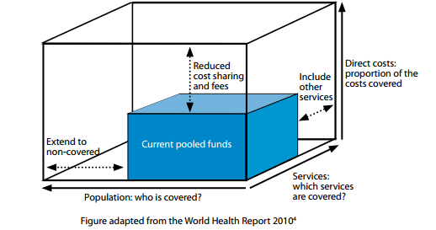
Advancing Towards UHC
    Making Choices for EPI
    Which EPI services for roll out
    When to include more people?
    How to reduce OOP for EPI?

Slide 42
How Does Immunization Fit Into Universal Health Coverage?
Immunization Services Coverage
  Global immunization coverage target - 90%
  Every contact with the health system must be seen as an opportunity to immunize
  Most children unimmunized are the same ones missed by health systems*
  To raise the bar on global immunization coverage - must reach the unreached
    Nigeria: integration of routine primary-care services and polio eradication activities in rural areas**
Ability to provide access to immunization services is central to UHC
*Dr Jean-Marie Okwo-Bele, Director of Immunization, Vaccines and Biologicals at WHO. https://www.who.int/news-room/detail/17-07-2017-1-in-10-infants-worldwide-did-not-receive-any-vaccinations-in-2016 . ** Bawa et al (2018) WHO Bulletin. BLT/2018/211565.
Notes:
** For example from Nigeria, See Bawa et al (2018) WHO Bulletin. BLT/2018/211565.
-Integrating routine primary-care services into polio eradication activities in Nigeria resulted in increased coverage for supplemental oral polio vaccine doses and essential maternal, newborn and child health interventions.

Slide 43
Sources of Revenue for
Universal Health Coverage (UHC)
Ensuring adequate financial resources
UHC will imposes new costs and requires new revenue
Requires “budgetary room” called “fiscal space”
  Economic growth creates fiscal space naturally through increased tax revenues – but not enough
  Disease prevention (e.g. immunization) creates fiscal space
Governments must also make health a priority in budgets
  Can broaden the tax base and improve tax administration
  Dedicate revenue sources for UHC
    Social health insurance contributions
    Improve efficiency
    Obtain grants
    Temporarily borrow

Slide 44
Sources of Revenue for
Universal Health Coverage (UHC)
Immunization programs require allocations that must be costed
  Purchasing vaccines, injection supplies, cold chain equipment
  Managing and transporting vaccines
  Delivering immunization services (labor costs)
Getting the most from available funding
  Efficient systems and logistics
    Better task sharing
    Lower wastage
  Improve value for money → Strategic purchasing
    Strategies that help countries pay lower prices for health commodities
    Incentivize health providers to improve the quality and coverage of their services
Notes:
See R4D 2017, Briefs 11, 12, and 14

Slide 45
Strategic Purchasing
Give examples of what happens without strategic purchasing
Give examples of strategic purchasing
Notes:
pay for performance our contracting out/in for service

Slide 46
UHC Requires Equity in Health Coverage
Providing UHC and financial protection for the entire population
Requires significant redistribution and cross-subsidization
Key issue related to immunization (to ensure 90% coverage target overall & 80% in every district)*
  Extending services to hard-to reach areas & populations
Rich
Healthy
Young
→
→
→
Poor
Greater health needs
Elderly
*Global Vaccine Action Plan goals for DTP3-containing vaccine by 2015 and for all vaccines in the national schedule, unless otherwise recommended, by 2020

Slide 47
National Health Financing & Immunization
How countries finance UHC determines
Priority given to immunization
How access and payment for immunization services is ensured
National Health Financing Overview
Mixed health financing models *
  Combine national budgets with public health insurance schemes
    Increasingly popular in LMICs
  Private financing through voluntary insurance
    Experience shows it cannot be the basis for achieving UHC**
    May have limited role (e.g. supplemental insurance)
    Less popular
Private health providers
  In many countries play a growing role in health service provision
  Increasingly contracted through public financing arrangements
Sources: ** Loganathan, Tharani et al (2016) *Kutzin 2012
Notes:
(health financing and service delivery arrangements put in place)

Slide 48
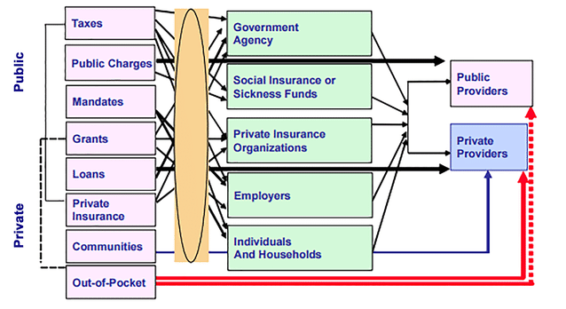
Immunization Financing in Context of Universal Healthcare Coverage
Notes:
Picture source????

Slide 49
UHC and Vaccine Financing
Keep Vaccine Financing Separate
Integrate Vaccines into Benefits Package of Universal Insurance
Separate “vaccines fund”
Pays for vaccine delivery
Arranges subsidized vaccines to flow to public and private providers
Private and public sector providers compensated out of insurance funds
What are the pros and cons of separate vs. integrated financing in local context?
Is it possible to do both simultaneously?
UHC: Universal Healthcare Coverage
Notes:
The advantage of including vaccines into the benefits package is that they can keep a population healthier and therefore, the HI fund doesn't need to support the costs of treating these illnesses (sustainability issue).

Slide 50
Vaccine Delivery
Vaccines don't deliver themselves - robust public healthcare systems need to be in place to support vaccine delivery
  This requires financing
  Vaccine delivery financing
    Usually allocated at the subnational level
    National levels are involved less and less in financing direct service delivery.

Slide 51
Summary of Key Points
Ensuring access to immunization services is central to the global movement toward universal health coverage (UHC).
Immunization financing should be considered in the context of broader government health financing policies and approaches to achieving UHC.
As health financing and service delivery arrangements become more complex, countries face the challenge of defining institutional responsibilities for specific immunization program functions and ensuring that financial incentives in the system do not disadvantage immunization services.

Slide 52
References & Resources
Part 1. Brief 2. pg 21-22, Results for Development (R4D). Immunization financing: a resource guide for advocates, policymakers, and program managers. Washington D.C.: R4D; 2017.
Bawa, Samuel, McNab, Christine, Nkwogu, Loveday et al. Achieving universal health coverage: implementation of a polio eradication intervention to deliver integrated primary health services to hard-to-reach and underserved communities in Nigeria Research. WHO Bulletin. (Accepted: 2018) BLT/2018/211565.
Ghebreyesus, Tedros Adhanom. All roads lead to universal health coverage. World Health Organization: Commnet. July 17, 2017. http://dx.doi.org/10.1016/S2214-109X(17)30295-4.
Loganathan, Tharani, Mark Jit, Raymond Hutubessy, Chiu-Wan Ng, Way-Seah Lee and Stephane Verguet. Rotavirus vaccines contribute towards universal health coverage in a mixed public–private healthcare system. Tropical Medicine and International Health; Vol 21, 11, pp1458–1467; 2016. doi:10.1111/tmi.12766

Slide 53
Section A3
Components of Immunization Costs
Note: This section only provides a summary of key immunization costs and how they relate to financing of immunization programs. For a full evaluation of immunization costs see the TVEE module focused on Immunization Costs.
Notes:
Summary of
What are the key components of immunization costs, and how do they vary across delivery platforms?
Which costs are typically shared with other health services?
Which costs are specific to immunization?

Slide 54

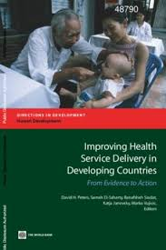
Immunization Costs & Financing
Immunization costs at multiple levels can be difficult to disentangle
Occur at different levels of the health system
Include several major components that may be financed differently
Need to understand key components of immunization costs in order to effectively budget for, finance, implement, and maintain a comprehensive immunization program
Centralized coordinating agency
Procurement of vaccines
Point of service delivery
Shared costs
Etc.
Injection supplies
Supply chain and logistics, Etc.
Immunization
Notes:
Link admin:
https://kissflow.com/wp-content/uploads/2018/09/Purchase-Order-Management_blog.png
Link Service:
https://www.google.com/url?sa=i&rct=j&q=&esrc=s&source=images&cd=&cad=rja&uact=8&ved=2ahUKEwiKyfHu8aPjAhWMUt8KHVTBApIQjRx6BAgBEAU&url=%2Furl%3Fsa%3Di%26rct%3Dj%26q%3D%26esrc%3Ds%26source%3Dimages%26cd%3D%26ved%3D%26url%3Dhttps%253A%252F%252Fopenknowledge.worldbank.org%252Fhandle%252F10986%252F12335%26psig%3DAOvVaw2gTVBMDwMpgniP6BGdxAPm%26ust%3D1562626040761381&psig=AOvVaw2gTVBMDwMpgniP6BGdxAPm&ust=1562626040761381

Slide 55
Major Cost Components of
Immunization Services
Two major categories
Vaccines and injection supplies (extensive)
Delivery to the country
Immunization delivery
Health worker time: administer vaccines, training, planning, management and supervision, social mobilization, surveillance, monitoring and evaluation
Supply chain & logistics costs: cold chain equipment and overheads, vehicles, transportation, and personnel time involved in the storage and delivery of vaccines to point-of-care settings
Capital Costs: transportation fuel, refrigeration units, salaries, maintenance of cold chain equipment (frequently under budgeted in immunization planning**)
Recurrent Costs: purchase of new trucks, motorcycles, and refrigeration units
Fees associated with clearing customs
Import taxes
Procurement fees, if relevant

Slide 56
Global Trends
Expenditures on vaccines and on immunization delivery is rising most places
Non-vaccine costs account for nearly half of immunization costs

Slide 57
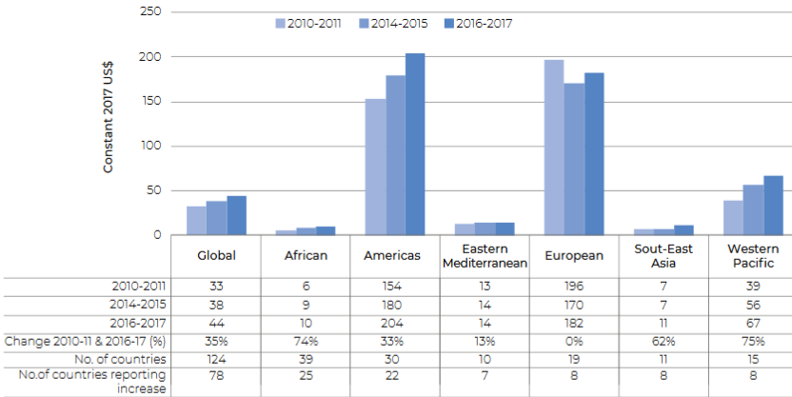
Government Expenditure on
Routine Immunization Delivery per Live Birth
Population-weighted average
Source: Global Vaccine Action Plan, WHO Secretariat Report (2018)

Slide 58
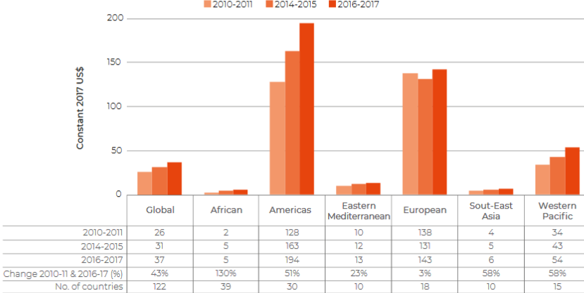
Government Expenditure on
Vaccines per Live Birth
Population-weighted average
Source: Global Vaccine Action Plan, WHO Secretariat Report (2018)

Slide 59
Total national cost shares of routine infant immunization by administrative level
Site-level costs (including vaccine costs) represented 77–93% of total national costs
Source: Fangli Geng, et al (2017)

Slide 60
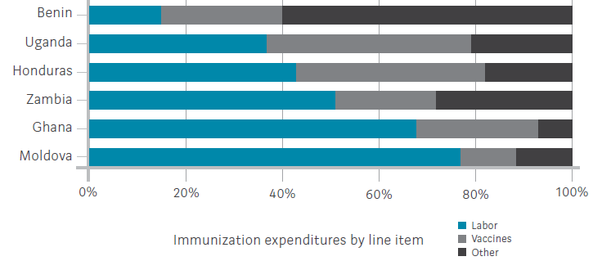
Costliest Inputs and Activities
Out of total immunization costs
Labor (average of 49%, range: 15% in Benin, 77% in Moldova)
Vaccines and injection supplies (average of 27%)
Large share - Efficient procurement and careful choice of presentation (the # of doses and total volume per vial) are critical to determining the cost of services
Routine Immunization Expenditures in Six Countries (2011)
Source: Brenzel et al., Health Affairs (2016)
Notes:
Labor-Immunization labor costs tends to correlate with level of economic development
--Developed countries have higher health worker salaries -- therefore higher proportional costs for labor
Administration and management costs above the facility level account for about 15% of total routine immunization costs.

Slide 61
Costliest Inputs and Activities
Out of total immunization costs
Labor (average of 49%, range: 15% in Benin, 77% in Moldova)
  Immunization labor costs tends to correlate with level of economic development. Developed countries have higher health worker salaries -- therefore higher proportional costs for labor
Vaccines and injection supplies (average of 27%)
Large share - Efficient procurement and careful choice of presentation (the # of doses and total volume per vial) are critical to determining the cost of services
Routine Immunization Expenditures in Six Countries (2011)
Source: Brenzel et al., Health Affairs (2016)
Notes:
Labor-Immunization labor costs tends to correlate with level of economic development
--Developed countries have higher health worker salaries -- therefore higher proportional costs for labor
Administration and management costs above the facility level account for about 15% of total routine immunization costs.

Slide 62
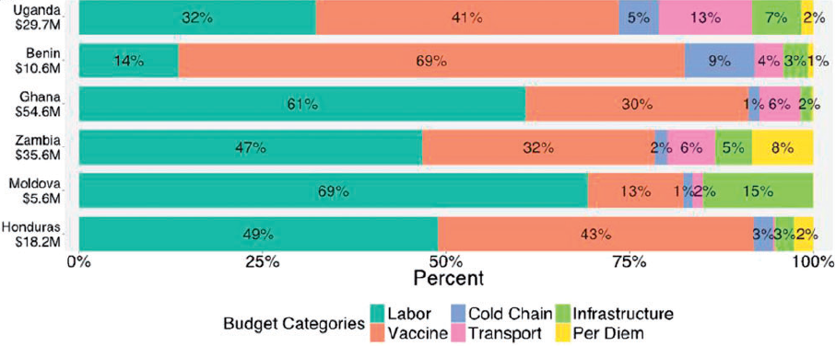
Cost shares of site-level infant immunization by country and budget category
Labor & vaccine costs formed the largest share of total costs
  73–92% of the total cost across the six countries
  Labor is the largest share
Wide variation at this level between countries
  Moldova: Labor cost = 5 * Vaccines cost
  Benin: Vaccines cost = 5 * Labor cost
Source: Fangli Geng et al (2017)

Slide 63
Cost per Fully Immunized Child
Ghana: $60 (2011USD)*
Honduras: $132 *
Moldova: $332 *
India: $32.43 (2017USD - District range: 23.28 - 57.86) * *
Much higher than previous 10-20 years *
  Countries had many fewer vaccines
    Ghana - US$10 in 2001
    Honduras - 20% of the cost per fully immunized child was for the two most recent vaccine introductions (rotavirus & pneumococcus)
Sources: *Brenzel et al., Health Affairs (2016) **Chatterjee et al., BMJ Global Health (2018)
Cost estimates use cost/DTP3 vaccinated child as a proxy because countries have different vaccine schedules and so full immunization will be different across countries.
Notes:
US$1=INR 64;
We used cost/DTP3 vaccinated child as a proxy for this, because countries have different vaccine schedules and so full immunization will be different across countries.

Slide 64
How Facility Volume Affects Costs
Wide variations in total and unit costs for immunization
Higher-volume facilities typically have lower unit costs (per dose given or per child vaccinated)
  Fixed costs are spread over a greater number of outputs
  Examples: Empirical data on routine infant immunization in Benin, Ghana, Honduras, Moldova, Uganda, and Zambia. Menzies et al, BMC Medicine (2017)
    Higher service volume was strongly associated with lower average costs
    Doubling of service volume was associated with a 19% (95% interval, 4.0–32) reduction in costs per dose delivered (range 13% to 32% across countries)
    The largest 20% of sites in each country realized costs per dose that were on average 61% lower than those for the smallest 20% of sites, controlling for other factors.
Rural facilities → lower volume (serve sparsely populated areas) → higher costs per dose
  Achieving high immunization coverage in more rural areas could cost more per dose than in highly populated areas
Notes:
show how for the same level of doses delivered, a country can have widely varying costs. (Graphic?)

Slide 65
Costs for New Vaccines
Delivery Platform Affects Delivery Costs
School based delivery (SBD) strategies are more costly for human papillomavirus (HPV) vaccination than health-facility based delivery
  SBD may be needed in places where it is the more effective strategy
Startup Costs for New Vaccine Introduction
Vaccine procurement and associated injection supplies
Incremental delivery costs
Array of important one-time startup activities
  Training of health workers, social mobilization, microplanning, and printing of new vaccine cards and training materials
May require additional investment in cold chain storage
  However, certain combination vaccines (such as pentavalent or hexavalent vaccines) may replace several previously separate vaccines, thereby reducing demand for cold chain space and injection supplies

Slide 66
Gaps in Immunization Cost Data
Despite recent detailed costing studies, there are large gaps in cost data
  Substantial gaps: Delivery costs in Central Asia, South Asia, and Europe
  Fewer studies conducted on immunization costs in low-income countries than in middle-income countries
  Many countries have added new vaccines→ older cost studies might be outdated or handle shared costs in an inconsistent way
  Most evidence → focused on routine immunization → need more cost data on the cost of supplementary immunization activities
    Reach large populations that might have been missed by routine immunization services and often immunize children whatever their vaccination history
  Other data gaps:
    Costs of various delivery platforms
    Costs of achieving higher coverage and greater equity
    Costs of better-quality services

Slide 67
Summary of Key Points
Immunization costs include vaccines, labor, supplies, transportation, operations and maintenance, cold chain equipment, and capital investments in buildings and technology. Labor and vaccines are the major cost components
Delivery costs (non-vaccine costs) account for nearly half of immunization costs
In health facilities and at the administrative level, immunization costs are typically shared across multiple health services and activities
  Adequately budgeted and staffed primary health services are essential to delivering comprehensive immunization services
Studies on immunization costs have found significant variation in total facility and unit costs
High-volume health facilities tend to have lower immunization costs per child than facilities in rural areas.
  This should be taken into consideration in budgeting and resource allocation
New vaccine introduction requires one-time startup cost that must be adequately budgeted for

Slide 68
References & Resources
Part 1. Brief 3., Results for Development (R4D). Immunization financing: a resource guide for advocates, policymakers, and program managers. Washington D.C.: R4D; 2017.
Global Vaccine Action Plan. Monitoring, Evaluation & Accountability. Secretariat Annual Report 2018. Geneva: World Health Organization; 2018. License: CC BY-NC-SA 3.0 IGO.
Chatterjee S, Das P, Nigam A, et al, (2018), Variation in cost and performance of routine immunisation service delivery in India, BMJ Global Health 2018;3:e000794., https://gh.bmj.com/content/3/3/e000794
Brenzel L, Schütte C, Goguadze K, et al. EPIC studies: governments finance, on average, more than 50 percent of immunization expenses, 2010–11. Health Affairs. 2016 Feb;35(2):259-65. https://www.healthaffairs.org/doi/full/10.1377/hlthaff.2015.1121
Fangli Geng, Christian Suharlim, Logan Brenzel, et al, (2017), The cost structure of routine infant immunization services: a systematic analysis of six countries, Health Policy & Planning https://academic.oup.com/heapol/article/32/8/1174/3859185
Nicolas A. Menzies, Christian Suharlim, Fangli Geng, et al, (2017), The cost determinants of routine infant immunization services: a meta-regression analysis of six country studies, BMC Medicine https://bmcmedicine.biomedcentral.com/articles/10.1186/s12916-017-0942-1
Griffiths, U.K., Bozzani, F.M., Chansa, C., et al (2016), Costs of introducing pneumococcal, rotavirus and a second dose of measles vaccine into the Zambian immunisation programme: Are expansions sustainable? https://www.sciencedirect.com/science/article/pii/S0264410X16304741
EPIC [Internet]. EPIC immunization costing studies. Available from: www.immunizationcosting.org

Slide 69
Section A4
Vaccine Finance Decision-Making

Slide 70
Outline
What needs to be decided?
  Financing to maintain core activities and keep them efficient
  Financing to expand coverage
  Financing to expand the set of vaccines
  How to build stable long-term vaccine financing systems
    Pre- and post Gavi graduation
What needs to be known?
  Costs of EPI, increased coverage, new vaccines
  Sources of fiscal space
  Elements of a long-term stable financing system

Slide 71
Routine Decisions
What can we do to keep the vaccination system running efficiently?
  Systems approach to the vaccine system
  Break down the system to elements and assess costs and outcomes
  Allocate funds to the system to improve efficiency
Where are bottlenecks?
Where are there economies of scale?

Slide 72
Decisions to Improve Coverage
Where are the “incremental unvaccinated” people located?
  Urban vs. Rural
  What age groups?
  How to locate?
Where can spending more improve coverage?
What systems improvements can sustain higher coverage?

Slide 73
New Vaccine Introduction Financing
New vaccines are considered on the basis of health gains per dollar
Finance question is how to sustain the new costs into the future?
Poses the question of timing pay today achieve benefits in future
Future generation needs to borrow from present generation so that it can benefit—how big of a loan should we take out on their behalf?
  We can borrow too much if we are greedy
  We can borrow to little if we forget that future generation will be richer than us and value their health more highly
Discount rates matter

Slide 74
Criteria for New Vaccine Introduction
Disease Burden and Public Health Importance
Vaccine Effectiveness and Safety
Delivery Requirements and Operational Feasibility
Cost
Cost-Effectiveness
Affordability
Acceptability and Public Demand
WHO Recommendations
Vaccine Design, Formulation, and Presentation
Support for Immunization Decision-Making
What would it take for a vaccine system to consider all of this simultaneously?
Notes:
See the NUVI exercise from Thailand

Slide 75
Elements of a stable vaccine financing system
Information: Costs and costs per covered person is known at national regional and local level
  A workforce exists to continually update the cost data
  Decision-makers routinely examine system efficiency and locate bottlenecks
Innovation: New attempts to increase coverage are tried out around the system and rigorously assessed
  Innovation funding is built in to the system because higher coverage requires doing new things
Engagement: An ongoing narrative continues to build social support about the value of vaccines
  Stories of lives changed by outbreaks that didn’t happen must keep circulating
  Disseminate to local stakeholders regularly

Slide 76
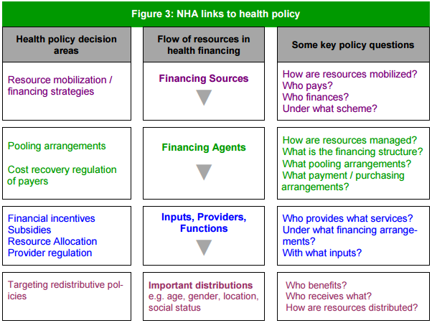
Health Policy Questions
Revenue collection
Pooling
Purchasing
Service provision
Pooling and procurement methods are beyond the scope of the financing module. Source: Diagram parts from WHO, Guide to Producing National Health Accounts.
Notes:
NOTE!!!: POOLING AND PROCUREMENT METHODS ARE BEYOND THE SCOPE OF THE FINANCING MODULE.
*To keep in mind throughout review of finance resources.
Revenue collection - the way health systems raise money from households, businesses, and external sources.
Pooling resources - accumulation of revenue to spread risks across population groups
Resource allocation and purchasing - how funds are channelled to pay for service provision

Slide 77
Critical Elements of Sustainable Finance
A Vaccine Economics Community of Practice
  Collecting regular cost data
  Collecting regular statements of value
  Engaging stakeholders
Information systems
  Tweaked to permit regular flow of cost data
Building the pipeline for the community of practice
  Need EPI offices to expect this expertise and create demand
  Schools need to build supply

Slide 78
Summary of Key Points
Decisions on introducing new vaccines have long-term implications for immunization costs as well as logistics systems and service delivery.
  The choice of vaccine presentation also affects cost and ease of delivery.
In making these decisions, policymakers should consider:
  disease burden; vaccine safety and efficacy; cost, cost-effectiveness, and affordability; operational feasibility and delivery requirements; and public perceptions and demand.
Independent technical committees, often called national immunization technical advisory groups (NITAGs), can help ensure that decisions on new vaccine introduction are transparent, credible, and grounded in evidence.
A variety of tools and assistance are available to help countries with decisions on new vaccines and to strengthen decision-making processes.
  PAHO’s ProVac Initiative is an impressive model of decision support.

Slide 79
References & Resources
Part 1. Brief 4., Results for Development (R4D). Immunization financing: a resource guide for advocates, policymakers, and program managers. Washington D.C.: R4D; 2017.
NITAG Resource Center [Internet]. NRC: About. Available from: http://www.nitag-resource.org/about
  A unique platform dedicated to secretariats and NITAG members. The aim is to develop the NITAG community, promoting collaborations and fostering the sharing of information
World Health Organization [Internet]. Immunization, vaccines and biologicals. Vaccine position papers. Available from: http://www.who.int/immunization/documents/positionpapers/en/
  BCG vaccines: WHO position paper – February 2018. No 8, 2018, 93,73–96. Link
Notes:
Link: https://apps.who.int/iris/bitstream/handle/10665/260306/WER9308.pdf;jsessionid=C291E073C9B49CF01D05CA3AAE4FC3D0?sequence=1

Slide 80
Section B
Sources of Financing

Slide 81
Section B - Sources of Financing
Learning Objectives
Essentials of health financing
  Assess financial flows in the health system & framework
Sources of financing
  Domestic Public Funding
  Household Out-of-Pocket
  Donor financing

Slide 82
Section B1
Health Financing Essentials

Slide 83
National Health Accounts
A country’s public finance system provides the financial backbone for realizing national health commitments
  Governments use revenue from different sources to finance the move toward universal health coverage (UHC) and the immunization services that are important for reaching UHC goals
National Health Accounts (NHA) are maintained in countries to provide information on
  Who is contributing to financing health care in a particular country?
  How much is being spent?
  How are health funds distributed across different institutions and services?
0
Picture source: WHO, Guide to producing national health accounts

Slide 84
National Health Accounts - Flow of Funds
Financing Sources
Financing Agents / Intermediaries
Providers
(Health services & Functions)
Beneficiaries (By age, sex, region, disease, income group)
  Domestic
    Public
      Taxes
      Social insurance (earmarked payroll taxes)
    Private
      Voluntary health insurance (firms)
      User fees (consumer OOP)
  Foreign / Development Assistance (In-kind)
    Bilateral Aid
    Multilateral Aid
    Foreign Firms
    National medical stores
    Supplies vaccines, injections and cold chain equipment
    Ministry of Health
    Conduct central immunization program functions / Budgets
    Public or Private Insurance funds
    Provide payment for immunization services
    Non-Governmental Orgs. (NGOs)
    Centers, clinics and hospitals, public health services
    Central government
    State/Local government
    Private
    NGOs
OOP: Out-of-pocket payment
Notes:
Sources of Finance for Vaccines
Intermediaries of Finance for Vaccines
Providers of Vaccination Services
Beneficiaries
Details for each in next slides
Domestic
Gov’t employee pools
Gov’t social insurance pools
Firms -
Consumers / Out-of-Pocket (OOP)

Slide 85
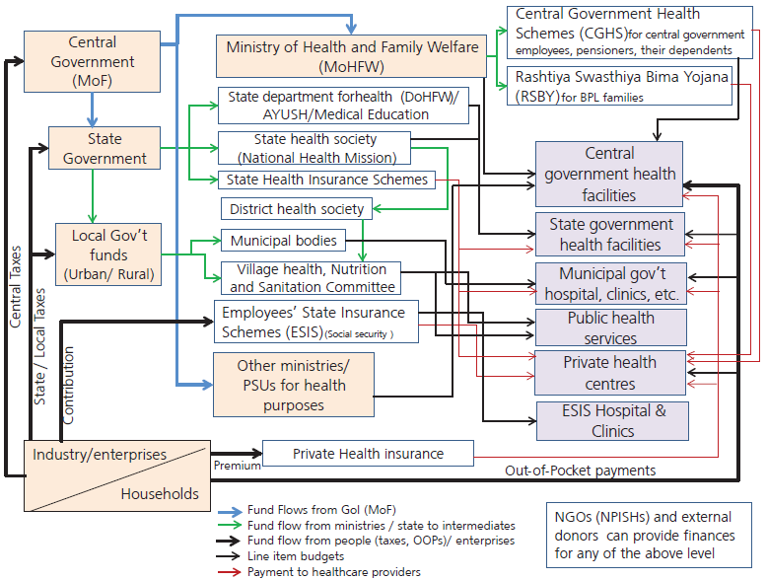
India Health
Financing Flows
Source: WHO, India Health Financing Profile 2017: India (2013-2014)

Slide 86
References & Resources
Part 2. Results for Development (R4D). Immunization financing: a resource guide for advocates, policymakers, and program managers. Washington D.C.: R4D; 2017.
Kutzin J., Witter S., Jowett M., Bayarsaikhan D. Developing a national health financing strategy: a reference guide. Geneva: World Health Organization; 2017. (Health Financing Guidance No 3) License: CCBY-NC-SA3.0IGO
World Health Organization. Regional Office for South-East Asia. (‎2017)‎. Health financing profile 2017: India. World Health Organization. Regional Office for South-East Asia. https://apps.who.int/iris/handle/10665/259642. License: CC BY-NC-SA 3.0 IGO
National Health Systems Resource Centre (NHSRC). Technical Support Institute with National Health Mission (Government of India National Health Mission): Practice Areas - Healthcare Financing. http://nhsrcindia.org/healthcare-financing

Slide 87
Section B2
Financing Sources in Financing Immunization Programs

Slide 88
Domestic Funding
As countries transition away from donor support, domestic public funding sources play an increasingly important role in bridging the gap in financing
A study of 40 GAVI countries in 2008-11* showed government spending from all sources covered an estimated
  67% of total routine immunization costs
  76% of shared service delivery costs
Most of domestic funding spent at the primary health care level*
*Data from comprehensive multi-year plans (cMYPs) for immunization in 40 Gavi countries between 2008-11
Notes:
Some context details before going into the details about domestic sources

Slide 89
Domestic Funding
Domestic funding for health can come from public or private sources
Public sources include general revenue raised through
  Broad-based taxes at the national or subnational levels
  Public insurance contributions (mandatory)
  Public revenue sources that flow through government systems are more easily pooled and redistributed to achieve equity and financial protection
  Public sources may be complemented by “on-budget” external resources that flow through government accounting systems (e.g. sector wide approach)
Private sources include
  Private health insurance premiums (voluntary)
  Formal or informal user fees paid at the point of service

Slide 90
Domestic Funding - General Revenue Raised through Taxes
General revenue includes the money that governments raise through taxes on
  Personal income, corporate income and profits
  Property and inheritance
  Duties and imports, sales taxes and value-added
  Payroll taxes and/or taxes on profits from the sale of natural resources
Revenue is typically pooled in a consolidated fund and appropriated to pay public expenses through regular budgeting and planning cycles
Single fund combination: offers a better opportunity for redistribution and efficient allocation than other domestic resources that are not pooled in this way

Slide 91
Domestic Funding - General Revenue Raised through Taxes
The amount of general revenue collected depends on
    Breadth of the country’s tax base &
    Efficacy of tax collection and enforcement
Amount allocated to health --> determined in part by the budget process and how the government sets priorities during budget formulation
    The allocation to immunization is within the pool of health funding
    Most LMICs make allocations to vaccine purchases transparent through a dedicated budget line
  Both factors outside the health sector’s control
  Not a guarantee that immunization services will be funded, protected, or managed accountably
LMIC: Low- and middle income countries
Notes:
Ex: 98% of African countries reported that their government had a specific budget line item for vaccines

Slide 92
Domestic Funding - General Revenue Raised through Public Insurance Contributions
Some countries rely on earmarked payroll taxes or other mechanisms to generate revenue for the health system
Key - that social insurance contributions be allocated
  Effectively
  Efficiently
  Equitably toward health priorities (including immunization)
In some countries, social health insurance system focus on curative care
  Can shift priority away from immunization
  (i.e. Expansion of an insurance program, particularly one that focuses on curative services, can crowd out resources for immunization and other preventive services)
Some countries have non-universal contribution mechanisms
  Such as an “opt-in” scheme that includes immunization in its benefits package
  In such cases, must ensure that immunization is financed for those who remain uncovered!!
Notes:
Countries can create fiscal space for UHC by broadening the tax base, improving tax administration, introducing dedicated revenue sources for the health sector such as social health insurance contributions, improving efficiency, obtaining grants, and temporarily borrowing

Slide 93
Domestic Funding - General Revenue Raised through Other Domestic Revenue
  New sources of of funding outside of the power of the ministry of health
  Mechanisms include
  Domestic trust funds (can contain a mix of public & external funds)
    Don't generate much additional resources & require lots of effort (costs) to set up
    For immunization: only Bhutan
  Other earmarks (including lotteries)
    Earmarking may not actually provide more money over the long run if it results in cuts to other parts of the health budget
    Earmarking government budget is not ideal because it doesn't optimize what a government produces → Can lead to allocative inefficiencies
  Few countries have established these mechanisms for immunization financing
    Requires careful consideration of pros and cons
Notes:
The point that needs to be made here is that:
Trust funds often don't generate much additional resources, and require lots of effort (costs) to set up. for immunization: only Bhutan
Earmarking government budget is not ideal because it doesn't optimize what a government produces. Can lead to allocative inefficiencies

Slide 94
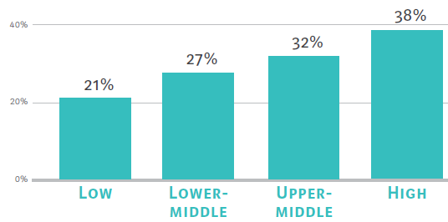
Economic Growth and
New Fiscal Sources for Health
More economic growth→ More tax revenue
Reliance on patients’ out-of-pocket (OOP) payments generally decreases as the national income level rises and, in turn, as overall access to publicly financed services expands
But, even as economies mature, most LMICs will continue to face constrained resources for health
  New fiscal space for health may be constrained by
    Inefficiencies
    Limited ability of the system to absorb and spend funds
    Corruption
    Diversion or misuse of funds
LMICs: low- and middle-income countries. Picture Source: RD4 2017
Notes:
But…
Economic growth can act as a signal for donors to pull out funding
It takes time for countries to broaden and strengthen their tax systems
in many countries - government budget allocation processes are poorly linked to policy and planning
→Even if health is a stated priority, budget allocations may not reflect it

Slide 95
Domestic Funding Sources -
Implications for Immunization Financing
Even when domestic public resources (or the systems through which they flow) are constrained → they are still attractive because they can be:
  Governed by existing general budgetary controls
  Integrated into the health financing architecture
  Used flexibly to meet immunization program needs
Domestic public sources (particularly general revenue) is often more predictable, equitable, efficient, and sustainable than other revenue sources
  Well-timed and coordinated budget advocacy can play an important role in improving the level, prioritization, and stability of general revenue flows
    Including immunization
Options to consider for countries with irregular timing of funding flows
    Negotiating release of time-sensitive funding early in the fiscal year (e.g., Armenia - for vaccine procurement)
    Using the Vaccine Independence Initiative (VII) as a way to bridge intermediate gaps
    Tapping commercial lines of credit or guarantees to provide more liquidity for the purchase of time-sensitive essential commodities
Notes:
Best option in terms of being
Armenia examples, see RD4 2017 Brief 19
VII, see (see Brief 13)
Domestic public sources (particularly general revenue)

Slide 96
Example 1 - India

Slide 97
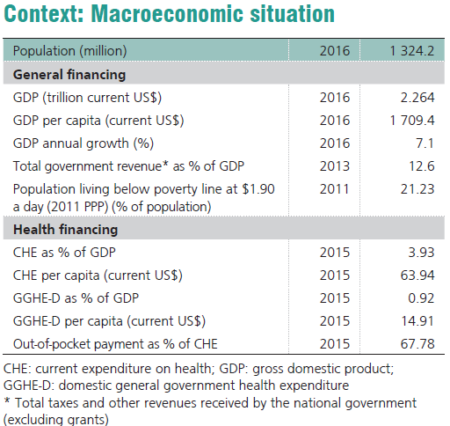
Health Financing in India
Background
Immunization Program in India → Introduced in 1978 as “Expanded Program of Immunization” (EPI) by the MOH and Family Welfare
In 1985, modified as “Universal Immunization Program” (UIP) to cover all districts by 1990
  One of largest health programs in the world
  Provides several vaccines to infants, children and pregnant women. Vaccines: https://www.nhp.gov.in/universal-immunisation-programme_pg
Source: WHO, Health financing profile 2017: India
Notes:
-Current health expenditure expressed as a percentage of GDP: Estimates of current health expenditures include healthcare goods and services consumed during each year. This indicator does not include capital health expenditures such as buildings, machinery, IT and stocks of vaccines for emergency or outbreaks.
-Domestic general government health expenditure: Public expenditure on health from domestic sources
*Current expenditure on health (CHE) as a share of gross domestic product (GDP) has been stable since 2000, averaging 3.84%. Private expenditure as a share of CHE is three times more than government’s.
*High OOP payments contribute to a serious lack of financial protection.
Info. Links:
-World Health Organization. Regional Office for South-East Asia. (‎2017)‎. Health financing profile 2017: India. World Health Organization. Regional Office for South-East Asia. https://apps.who.int/iris/handle/10665/259642. License: CC BY-NC-SA 3.0 IGO
-National Health Systems Resource Centre (NHSRC). Technical Support Institute with National Health Mission (Government of India National Health Mission): Practice Areas - Healthcare Financing. http://nhsrcindia.org/healthcare-financing
--Document: National Health Systems Resource Centre (2018). National Health Accounts Estimates for India (2015-16), New Delhi, Ministry of Health and Family Welfare, Government of India.
Maybe….
-https://www.nhp.gov.in/universal-immunisation-programme_pg
April 28, 2019: https://www.business-standard.com/article/health/how-india-can-achieve-full-immunisation-coverage-of-its-population-119042800012_1.html
-https://www.who.int/news-room/fact-sheets/detail/immunization-coverage

Slide 98
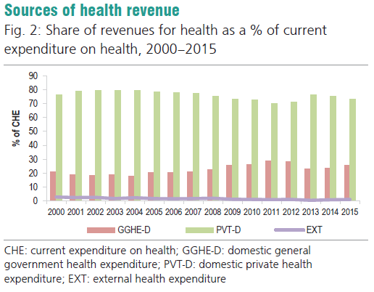
Health
Financing
in India
Source: WHO, Health financing profile 2017: India
Notes:
Domestic private: voluntary health insurance & consumer user fees
Domestic gov’t: taxes and public insurance
EXT/donor: small % and decreasing over time

Slide 99
In India:
What are the sources of financing for public and private health expenditure and for immunization expenditure?
What are the differences between mandatory vs. voluntary health insurance?

Slide 100
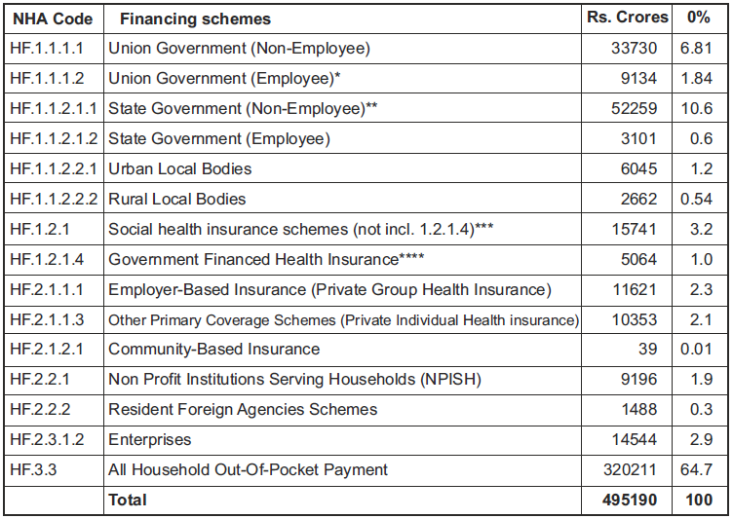
India - Healthcare Financing (HF) Schemes &
Health Funding Source (2015-16) Data
HF.1 Public
HF.1.1: Government Schemes
HF.1.2: Compulsory Contributory Insurance Schemes†
HF.2 Private
HF.2.1: Voluntary Health Insurance
HF.2.2: Non- Profit Institutions Serving Households (NPISH)
HF.2.2: Enterprise Financing
Notes:
The list here are health financing schemes in India (List of who spends the money). (We talk about different types of HF schemes in different countries in another module section). Here we describe what is in India only, how the scheme is laid out.
†HF1.2.1 Financed by employees (HH prepayments), employers, & union/state gov’t contributions
†HF1.2.1.4. Financed by union/state gov’t contributions
HF.1: All expenditures through
-the Government (Union, State & Local Governments) and
-Social Health Insurance agencies
For providing healthcare services to:
-General population as well as to
-Government employees
HF.1.1.1.1 Union Government Schemes (Non-Employee): Expenditure through Ministry of Health and Family Welfare, other Union Ministries & Departments for providing healthcare services to general population are classified here. Includes expenditures under National Health Mission, National Family Welfare Programmes, National AIDS Control Program, IEC programmes, partnership with NGOs, etc. It also includes expenditures through other Union Ministries and Departments under the Labour Welfare Scheme, Maulana Azad Medical Aid Scheme, National Institute of Sports Science and Sports Medicine, etc. (Refer NHA Guidelines for India, 2016 for details).
HF.1.1.1.2 Union Government Schemes (Employee): Expenditure by Ministry of Health and Family Welfare and other Union Ministries and Departments for providing healthcare services to their employees and their dependents are classified here. It includes expenditures by Ministry of Defence, Ministry of Railways, Department of Posts and Department of Atomic Energy, etc. for providing healthcare services to their employees and reimbursements under Central Services Medical Attendance (CSMA) Rules.
HF.1.1.2.1.1 State Government Schemes (Non-Employee). Expenditure by Department of Health and Family Welfare and other Departments of the various State Governments for providing healthcare services to the general population are classified here. This includes expenditures under Urban and Rural Health services- Allopathy and Other Systems of Medicine, Public Health, Family Welfare, Health Statistics & Evaluation, etc. It also includes healthcare related programs by other departments like Department of Labour, Art and Culture, Social Security, Welfare and Nutrition, Welfare Of SC/ST and OBC, etc.(Refer NHA Guidelines for India, 2016 for details)
HF.1.1.2.1.2 State Government Schemes (Employee). Expenditure by Department of Health and Family Welfare and other Departments of the various State Governments for providing healthcare services to their own employees are classified under this scheme. This includes medical reimbursements to State Government Employees and their dependents by all State departments.
HF.1.1.2.2.1 and HF.1.1.2.2.2 Local Bodies Scheme. Expenditure by Urban Local Bodies and Rural Local Bodies on healthcare services to the general population, through the programmes and/facilities run by the local bodies.
HF.1.2.1 Social Health Insurance. Expenditure of Central Government Health Scheme (CGHS), Employees’ State Insurance Scheme (ESIS), Ex-servicemen Contributory Health Scheme (ECHS) are classified here. Even though Contributory Health Services Scheme (CHSS) of Department of Atomic Energy and Retired Employees’ Liberalized Health Scheme (RELHS) of Ministry of Railways are Social Health Insurance, due to non-availability of disaggregated financial data their expenditures have been included under Union Government Employee Schemes. Social Health Insurance are financed by the contributions of employees (household’s prepayments), employers (enterprises), Union and State Government grants/contributions.
HF.1.2.1.4 Government Financed Health Insurance schemes. This includes expenditure under all health insurance schemes implemented by Union and State Governments in 2015-16. These are Rashtriya Swasthya Bima Yojana and other State specific Government health insurance schemes that are enumerated under the section on health insurance expenditures of this report. These schemes are financed by Union and State Government through specific grants or contributions to a private or public insurance company. Some schemes also have a component of token contributions from households. These expenditures in NHA 2013-14 and 2014-15 were classified under the code HF.2.1.1.2 Government Based Voluntary Insurance. However these expenditures were always considered part of the Total Government Expenditures for all analysis and reporting purposes. For NHA 2015-16 the expenditures of these schemes were classified as HF 1.2.1.4 considering other country experiences of classifying such similar schemes as Government Schemes under appropriate codes of HF.1 and discussions with experts to maintain global comparability. To reinterpret the classification, SHA 2011 definitions under Table 7.2 Main Criteria of health care financing schemes and Chart 7.2 Criteria tree forhealthcare financing schemes was considered (page 163 and 164)*** . These fit the code HF 1.2.1 as the payments for some of these schemes (like RSBY) are contributory and entitlements are based on enrolment requiring actions to be taken by the eligible persons. Contributions are non-risk related and a share of the total contributions can be made by the Government from budgetary allocations. Thus a separate sub code HF 1.2.1.4 was created so that these are presented separately for policy purposes but are part of HF 1.2.1 code definitions. Due to this change in NHA 2015-16, the contributions by eligible households paid for enrolment are considered as other social contributions FS.3.4 instead of FS.5.1 Voluntary Prepayment from individuals/ households as in NHA 2013-14 and NHA 2014-15.
HF.2: Expenditure through all the voluntary healthcare payment schemes classified as
HF.2.1 Voluntary Health Insurance Schemes
HF.2.2 Non- Profit Institutions Serving Households (NPISH) Schemes
HF.2.3 Enterprise Financing Schemes
HF.2.1.1.1 Employer Based Insurance Schemes (Private Group Health Insurance). This includes expenditure under the Group Health Insurance (Non-Government) category defined by the Insurance Regulatory and Development Authority of India (IRDAI) net of the Micro Health Insurance. Micro Health Insurance is considered as Community based insurance with maximum annual coverage of Rs 30,000 per annum. Group Health Insurance are financed by the contributions of employees (households prepayments), employers (enterprises) in the form of premiums paid to public/ private insurance company.
HF.2.1.1.3 Other Primary Coverage Schemes (Private Individual Health Insurance). This includes expenditures under Individual insurance category defined by the Insurance Regulatory and Development Authority of India (IRDAI) net of the Micro Health Insurance. These are financed by household prepayments.
HF.2.1.2.1 Community based Health Insurance Schemes. Expenditure of insurance schemes operated / organized purely by communities themselves/ NGOs/ cooperative societies/ workers unions etc. Many of community schemes since 2006 use private/ public insurers for risk pooling and these products are registered as Micro Health Insurance Products under the IRDAI. Expenditures from both these categories are included. These are financed by household prepayments.
HF.2.2.1 Non- Profit Institutions Serving Households (NPISH) Schemes. These are institutions established and operated purely on a philanthropic funding or by receiving foreign aid. They may have a network of their own healthcare facilities and/or deliver healthcare services through single hospital or clinic. Healthcare services are generally provided free or at subsidised cost. Revenue is from the donations of general public, aid through Government budgets, contributions from philanthropists, corporations, foreign aid, user fees, etc.
HF.2.2.2 Resident Foreign Agencies Schemes. are NPISH schemes directly run through resident foreign government development agencies.
HF.2.3.1.2 Enterprises. Expenditure of large firms/corporations both in the public and private sector with their own network of health facilities that provide healthcare services to the employees and their dependents are classified under this. These healthcare facilities are financed through the enterprises themselves. In case they do not have their own facility, the enterprise may reimburse the medical bills of the employee or pay a lump sum payment towards healthcare expenditures.
HF.3.3 All Household Out-Of-Pocket Payment

Slide 101
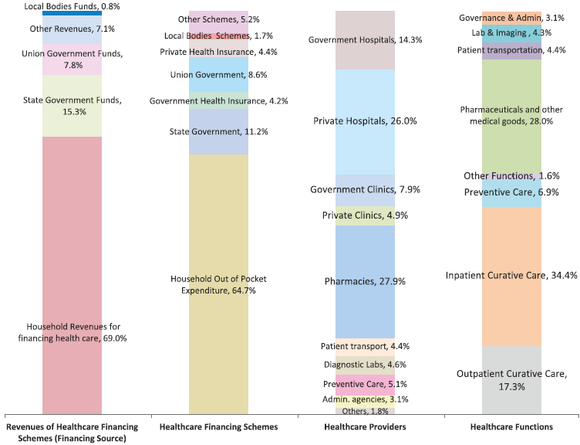
India - Distribution of Current Health Expenditure (2015-16) by Healthcare Financing Schemes, Revenues of Healthcare Financing Schemes, Healthcare Providers and Healthcare Functions (%)
HF.1
HF.2
HF.1
HF.1
HP.6
HP.3
Immunization programs health finance (HF) scheme:
HF.1: Gov’t scheme & contributory healthcare financing scheme
HF.2: Voluntary healthcare payment scheme, specifically:
All Household out-of-pocket payment
Non-Government Institutions Serving Households (NPISH)
Immunization Health providers (HP):
HP.6 Providers of preventive care
HP.3 (small %) Providers of ambulatory care
Preventive
care includes:
Immunization (0.87%)
Source: National Health Systems Resource Centre (2018). National Health Accounts Estimates for India (2015-16), Figure 1, Table A.3, Table A.4
Notes:
*Other:
Early disease detection (0.15%);
Healthy condition monitoring (2.79%);
Epidemiological surveillance, risk and disease
control (2.27%);
Preparing for disaster and emergency response (0.02%) & unspecified preventive care not elsewhere
classified (0.2%).
HF.2 for immunization programs includes: NPISH financing schemes (excluding Resident foreign agencies
schemes), and All Household out-of-pocket payment
--Non-Government Institutions Serving Households (NPISH)
Expenditure in (INR crores): total 4317

Slide 102
India - Distribution of Current Health Expenditure (2015-16) by Healthcare Financing Schemes, Revenues of Healthcare Financing Schemes, Healthcare Providers and Healthcare Functions (%)
HF.1
HF.2
HF.1
HF.1
HP.6
HP.3
Immunization programs health finance (HF) scheme:
HF.1: Gov’t scheme & contributory healthcare financing scheme
HF.2: Voluntary healthcare payment scheme, specifically:
All Household out-of-pocket payment
Non-Government Institutions Serving Households (NPISH)
Immunization Health providers (HP):
HP.6 Providers of preventive care
HP.3 (small %) Providers of ambulatory care
Preventive
care includes:
Immunization (0.87%)
Source: National Health Systems Resource Centre (2018). National Health Accounts Estimates for India (2015-16), Figure 1, Table A.3, Table A.4
Notes:
*Other:
Early disease detection (0.15%);
Healthy condition monitoring (2.79%);
Epidemiological surveillance, risk and disease
control (2.27%);
Preparing for disaster and emergency response (0.02%) & unspecified preventive care not elsewhere
classified (0.2%).
HF.2 for immunization programs includes: NPISH financing schemes (excluding Resident foreign agencies
schemes), and All Household out-of-pocket payment
--Non-Government Institutions Serving Households (NPISH)
Expenditure in (INR crores): total 4317

Slide 103
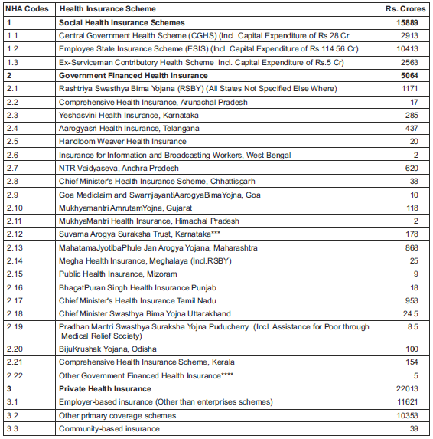
India – Different Health Insurance Schemes & Health Expenditure
(2015-16)
Mandatory
vs.
Voluntary?
Source: National Health Systems Resource Centre (2018). National Health Accounts Estimates for India (2015-16), Table 8

Slide 104
More on Earmarking to Finance Immunization
Earmarking - Setting aside some or all revenue from a tax or group of taxes for a designated purpose—is a domestic financing option considered by some countries for health, particularly as they transition away from donor support
  Authorities typically oppose it because earmarking can undermine their ability to allocate the budget most effectively
  Can “safeguard” funding streams for immunization (specially in times of gov’t cutback)
    But earmarked revenue can also shrink during economic downturn – limits adaptation
    Also, can reduce funds in other parts of the health budget – jeopardizing services essential for vaccine delivery (creates perception that immunization is “taken care of”)
  Funding sources should be structured to support, and not limit, changing funding requirements
A more holistic approach to general funding is likely to yield better results than advocating for earmarks
UHC: Universal healthcare coverage
Notes:
Pros and Cons of Earmarking for Immunization
Authorities oppose:
-Common to fund national health priorities, not common for immunization but part of the global conversation on domestic funding as countries transition away from donor-support
Can safeguard funding:
-Global experience suggests → effective for high national priority (e.g. UHC), but with budget rigity, effectiveness decreases overtime and creates leading inefficiencies

Slide 105
Types of Earmarking for Immunization
At least in 9 countries have legislation in place for earmarking. For immunization only 3: Bhutan, Bolivia, & Costa Rica
General Budget Earmarks for Immunization
  Legal government mandate to finance immunization
    Bolivia: Sets a certain % of funding by law to immunization programs
Taxes on Goods and Services
  No countries currently earmark tax revenue on specific goods and services for immunization - but some use funds from broader earmarks for health
    Philippines: taxes on alcohol/tobacco - 85% earmarked to health for the poor
    Ghana: MOH uses earmarked revenue from the National Health Insurance Scheme to fund vaccines purchases
MOH: Ministry of Health
Notes:
9 countries: Bhutan, Bolivia, Cameroon, Costa Rica, Mongolia, Nepal, Nigeria, Senegal, and Uganda

Slide 106
Types of Earmarking for Immunization
Lottery Revenues
    Costa Rica: national lottery every November, one draw dedicated to vaccines (1% of vaccine purchasing funding)
Domestic Trust Funds
  May receive funds from multiple revenue sources
  In theory - can help protect or manage sources of immunization funding, generate additional revenue through interest earned on investments, and promote donor confidence
    Can support accumulation of reserves by drawing down only a portion of gains from interest rather than drawing down capital
    Bhutan: One of the longest running dedicated to essential medicines like vaccines
  Limited experience – shows that trust funds for immunization and for other health priorities can be costly and complicated to establish, fund, and manage
MOH: Ministry of Health
Notes:
Countries with active legislative and operational processes to establish a trust fund: Cameroon, Nepal, Nigeria, Senegal, and Uganda

Slide 107
Household Out-of-Pocket Payments Funding Sources
User fees / copayments / cost-sharing:
Out-of-pocket (OOP) payments made by households (HHs) for immunization services
Governments include user fees in attempt to achieve high immunization coverage
  Obstacle to immunization – for the poorest HHs
  In India, HH OOP expenditure on health is 60.6% of THE. Private Health Insurance expenditure is 4.1% of THE
  Evidence suggests benefits of revenue are outweighed by negative impact on immunization coverage → parents are discouraged from vaccinating children
    Some LMICs discourage it – Instead institute conditional cash transfers to low income families
THE: Total Health Expenditure. Source: National Health Systems Resource Centre (2018). National Health Accounts Estimates for India (2015-16)

Slide 108
Household Out-of-Pocket Payments Funding Sources
Formal
Most gov’ts phasing out of formal user fees
Cost recovery was fairly low—less than 5% of total immunization costs
Phased out yield positive results
  Hepatitis B in China, with free vaccination coverage of the 3-dose HB vaccine increased from 60%-99% by 2015
Informal “off the books”
  When a public facility runs out of injection supplies → parents are forced to purchase syringes elsewhere
  Usually in countries that decentralized responsibility for procuring injection supplies
  Persist in some countries -- harder to track
When advocates probe for user fees for immunization in publicly financed facilities -- they should look into both formal and informal fees
Notes:
Phased out yield positive results :
-Hepatitis B was the leading cause of illness and death in China -- high fees and vaccination was low -- after government supported free vaccination (GAVI funding) coverage of the 3-dose HB vaccine increased from 60%-99% by 2015
-decentralized: contributed to stock-outs at facility level

Slide 109
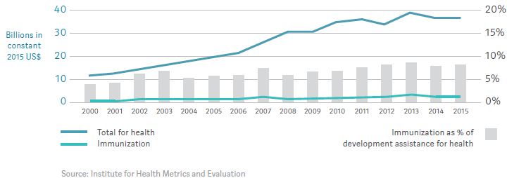
Donor Immunization Funding Sources
Development Assistance for Health and Immunization (2000 to 2015)
For immunization, the 5 largest channels of assistance
  Gavi (37.9%) → By 2015, 50%
  The Bill & Melinda Gates Foundation (14.9%)
  WHO (13.3%), U.S.-based nongovernmental organizations (9.4%)
  The U.K.’s Department for International Development (5.7%)
Notes:
Bilateral aid describes money which is given directly from one government to another
Multilateral aid comes from numerous different governments and organizations and is usually arranged by an international organization such as the World Bank or the U

Slide 110
Donor Immunization Funding Sources
Examples of Bilateral Agencies
Australia - Department of Foreign Affairs and Trade (DFAT, formerly AusAID)
Canada - Department of Foreign Affairs, Trade and Development (DFAIT, formerly CIDA)
France - Agence française de développement (AFD)
Germany - Federal Ministry for Economic Cooperation and Development (Bundesministerium für wirtschaftliche Zusammenarbeit und Entwicklung, usually referred to as BMZ/GIZ)
Italy – Italian Development Cooperation (IDC)
Japan – Japan International Co-operation Agency (JICA)
Norway - Norwegian Agency for Development Cooperation (NORAD)
Sweden – Swedish International Development Cooperation Agency (Sida)
United Kingdom – Department for International Development (DFID/UKAid)
United States – United States Agency for International Development (USAID)

Slide 111
Donor Immunization Funding Sources
Example of Multilateral Agencies
European Commission
The United Nations Children’s Fund
World Health Organization
The World Bank
Other UN agencies
  UNHCR

Slide 112
Donor Funding Sources
Forms of Assistance for Immunization
Grants (most immunization support is in the form of grants)
  Grants are transfers of resources: money, tech. assistance, commodities or equipment
    Gavi: vaccines, injection safety device, cold chain equipment, and health system grants
    USAID: multiple purposes -- cold chain equipment, Gavi proposal development, Expanded Program on Immunization (EPI) reviews, vaccine post-introduction evaluations, capacity building and learning materials
    JICA: tech. cooperation projects (also loans)
  Adverse effects (unsustainable, incur costs not budgeted for, have quality --such as expiry-- issues)
    See UNICEF and WHO’s joint statement on 5 key requirements to avoid adverse effects

Slide 113
Donor Funding Sources
Loans and credits
  Funds borrowed by country governments that must be repaid → negotiated with the country’s ministry of finance
  Provided by the World Bank and regional development banks
    Maintains a list of country eligibility requirements - depends on a country’s GNI per capita (threshold of US$1,215 in 2016)
  Important source of financing for middle-income countries without access to grants
  Economic growth leads to countries’ transition from grants to loans – some gov’ts are reluctant to borrow
Borrowing can be a sound investment if the benefits outweigh the costs & country has capacity to repay

Slide 114
Other Donor Funding Tools
Buy-downs of loans and credits
  Terms of loans and credits softened upon achievement of certain goals
  Most commonly when the eradication of the disease is a global “public good” (e.g., eradication of polio)
    It makes sense that the burden should not fall on individual countries involved in the final push for global polio eradication

Slide 115
Donor Funding Sources
Public-Private Partnerships (PPP)
An entity created through the joint effort of the public and private sector to address problems or issues of mutual interest that neither sector could tackle adequately on its own
Aim
  Capitalize on relative strengths of the public & private sectors to address an issue
    E.g., public sector contributes funding for basic science research with potential benefits for health such as discovery of a new vaccine; private sector raises capital, builds a factory and produces the vaccine
Examples of PPPs in global health
  Gavi, The Vaccine Alliance
  The Global Fund to Fight AIDS, Tuberculosis and Malaria
  Stop TB – Global Drug Facility
Notes:
More slide to section C1a

Slide 116
Donor Funding Sources
Gavi Financing for Immunization
Direct Funding
Governments
  Examples: Australia (DFAT), Canada (DFAIT), France (AFD), Germany (BMZ/GIZ), Italy (IDC), Norway (NORAD), United Kingdom (UKAid/DfID), United States (USAID)
Private Foundations
Advance Market Commitment (AMC)
Donor commitment incentivizes vaccine production and access at lower cost
Gavi Matching Fund
Contributions from any entity matched by UK and BMGF
International Financing Facility for Immunization (IFFIm)
(See details here: http://www.gavi.org/funding/donor-profiles/ )
Bill and Melinda Gates Foundation | The Children’s Investment Fund Foundation
“La Caixa” Banking Foundation | Comic Relief
Alwaleed Philanthropies | ELMA Vaccines and Immunization Foundation
Notes:
Gavi, the Vaccine Alliance - founded by a partnership of major donors, international agencies, and leaders of the vaccine industry

Slide 117
Gavi Financing for Immunization
The largest channel of external financing for immunization, 2015 US$8.7 billion
Provides both*
  Commodities (vaccines, injection supplies, and equipment)
    Human papillomavirus (HPV), inactivated polio vaccine (IPV), Japanese encephalitis, measles, measles-rubella, meningitis A, pentavalent, pneumococcal, rotavirus, and yellow fever.
  Grants to support the introduction of vaccines, the operational costs of campaigns, and health system strengthening
    Health Systems and Immunization Strengthening (HSIS) support framework
Eligibility to receive assistance
Based on GNI per capita
  As of 2017, the eligibility threshold stood at US$1,580 average GNI per capita
  Once countries cross the threshold, they enter a 5-year “accelerated transition”
  After the 1st year of this transition, “grace year,” the country cannot apply for new vaccine support
WB: World Bank, GNI: Gross National Income
Notes:
India is in the middle of Gavi transition. The biggest challenges for transitioning countries is on the programmatic side-- what needs to be sustained post transition, how will it be delivered (could efficiencies be gained?), and what type of TA might be available? Gavi has post transition support now to provide catalytic, one-time support to strengthening processes, capacities, institutions.
As of 2017,
32 countries are in the initial self-financing phase,
15 are in the preparatory transition phase,
17 are in the accelerated transition phase.
*provides funding to UNICEF to procure these commodities rather than providing funds for their purchase directly to countries
Details: In 2016, Gavi began offering support for cold chain equipment upgrades

Slide 118
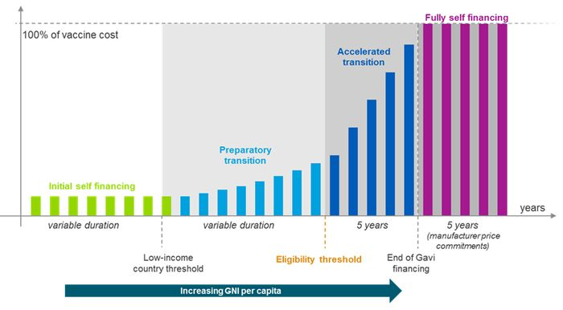
Gavi Transition Model, Co-Financing Policy
Countries in the World Bank’s Low-inc. category
Source: http://www.gavi.org/about/governance/programme-policies/eligibility-and-transition/
Notes:
Co-financing policy (picture: Co-financing requirements as of 2016)
-Gavi requires countries to pay for and procure (usually through UNICEF) a share of the vaccines that they have introduced with Gavi support
-Countries responsible for co-financing vaccines but also for covering the ongoing incremental supply chain, logistics, and service delivery costs associated with new vaccines, although sometimes other donors help cover these costs
-Co-financing obligations increase as countries grow economically:
---
-Helps prepare countries for full self-financing once Gavi support ends

Slide 119
GAVI Transition
Transition phases from Gavi support
  Initial self-financing phase – flat rate US $ 0.20 per dose
  Preparatory transition phase – government contribution increases by 15% p.a.
  Accelerated transition - government’s share of vaccine costs increases to 100% over 5 years
  Fully self-financing – no more Gavi support but may benefit from Gavi/AMC arrangements for 5 years
Preparations for transition from Gavi support
  Post-transition arrangements to ensure sustainable financing
  Capacity building
  On-going technical support
Post-transition issues
  May phase higher prices
    Several manufacturers have made commitments to keep the same price that Gavi pays or countries were paying for certain vaccines for set periods of time
  Governments must consider the long-term cost implications of new vaccines when making introduction decisions
More information at: www.gavi.org/library/gavi-documents/supply-procurement/
Notes:
Long-term cost implications:
-help governments weigh financial considerations
-make the case for immunization with decision-makers,
-calculate budget requirements,
-minimize costs through strategic purchasing,
-identify appropriate sources of financing,
-ensure sustainable and adequate immunization financing as they reform health sector financing more broadly
See the UNICEF Supply Division website for information on prices for vaccines supplied by UNICEF for Gavi
(http://www.unicef.org/supply/index_gavi.html).
See the Gavi website for information on Gavi support (http://www.gavi.org/support/) and on Gavi policies
(http://www.gavi.org/about/governance/programme-policies/).

Slide 120
GAVI Transition
Post-transition issues
Governments must consider the long-term cost implications of new vaccines when making introduction decisions
Help governments weigh financial considerations
Make the case for immunization with decision-makers,
Calculate budget requirements,
Minimize costs through strategic purchasing,
Identify appropriate sources of financing,
Ensure sustainable and adequate immunization financing as they reform health sector financing more broadly
More information at: www.gavi.org/library/gavi-documents/supply-procurement/
Notes:
Long-term cost implications:
-help governments weigh financial considerations
-make the case for immunization with decision-makers,
-calculate budget requirements,
-minimize costs through strategic purchasing,
-identify appropriate sources of financing,
-ensure sustainable and adequate immunization financing as they reform health sector financing more broadly
See the UNICEF Supply Division website for information on prices for vaccines supplied by UNICEF for Gavi
(http://www.unicef.org/supply/index_gavi.html).
See the Gavi website for information on Gavi support (http://www.gavi.org/support/) and on Gavi policies
(http://www.gavi.org/about/governance/programme-policies/).

Slide 121
Donor Funding Sources
World Bank Assistance
Has 4 main types of instruments relevant to health and immunization
  Investment project financing - support specific physical and social infrastructure
  Development policy financing - support a program of policy and institutional actions
    To address bottlenecks in service delivery (non-earmarked general budget financing)
  Program-for-results financing (RBF) - links disbursements to defined program results
  Trust funds and grants - help scale up activities or support activities in fragile and conflict situations

Slide 122
Example – Pakistan
A brief description of pooling and procurement mechanisms

Slide 123
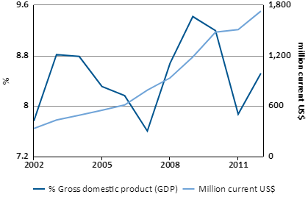
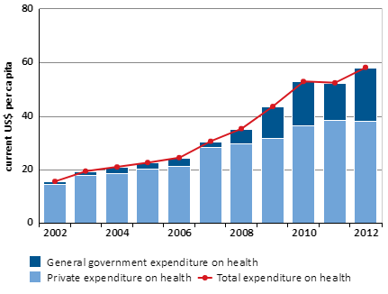
National Health Accounts in Pakistan 1995-2014
Trends in Financing Contributions
Total Health Expenditure
Total Health Expenditure per Capita
https://knoema.com/WHONHA2016/national-health-accounts-1995-2014

Slide 124
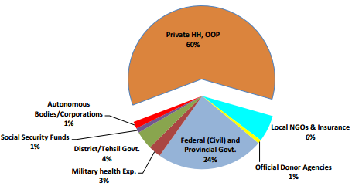
National Health Accounts in Pakistan 2013-14
Total Health Expenditure (THE) by Financing Agents 2013-14 %
Notes:
OOP is Out-of-pocket expenditure
HH is household

Slide 125
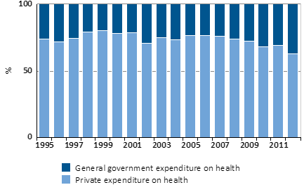
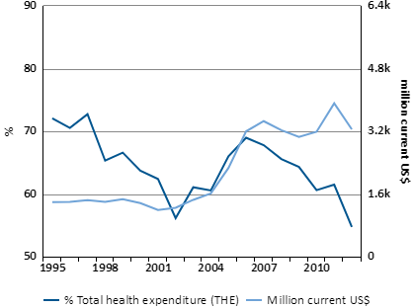
National Health Accounts in Pakistan 1995-2014
Trends in Financing Contributions
Private and Public Health Expenditure
Out of Pocket Health Expenditure per Capita
https://knoema.com/WHONHA2016/national-health-accounts-1995-2014

Slide 126
Pakistan - General Public Revenue
Direct taxes: levied “directly” on individuals or firms
Indirect taxes: levied on consumption, sale or trade (e.g. VAT, tariffs), including specific “sin” taxes on items that cause ill-health (e.g. tobacco, alcohol)
Zakat (religious tax)
National Health Accounts in Pakistan 2013-14

Slide 127
Pakistan - Private Revenue
Out-of-pocket payment: Including from Individual savings accounts for health [not pooled]
Voluntary pre-payment: Mostly private insurance & community-based health insurance [pooled]
Compulsory contributions from industry: Corporate Social Sector Responsibility
Philanthropic / citizens contributions
Committee saving schemes
National Health Accounts in Pakistan 2013-14

Slide 128
Pakistan – Types of External Revenue
Loans / Grants
  Specific for the Expanded Programme on Immunization (EPI)
  Program support for RMNCAH*
  Sector support for Health
Project Proposal
Budgetary Support
  Disbursement linked Indicators mechanism (DLI)
  e.g. under DLI mechanism the funds would be disbursed to the provinces on achievement of desirable results after the verification by Federal EPI through third party
*Reproductive, Maternal, Newborn, Child and Adolescent Health
Notes:
DLI: https://reliefweb.int/report/pakistan/government-strengthen-immunization-program-through-national-immunization-support

Slide 129
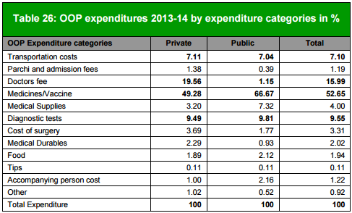
Distribution of Out-of-Pocket Expenditure
Data from Pakistan
National Health Accounts in Pakistan 2013-14

Slide 130
Pakistan - Pooling
Accumulation of prepaid health revenues on behalf of a population for eventual transfer to providers
Different public and private risk pooling Mechanisms:
  Government revenues
  Social health insurance
  National health service
  Community based insurance
  Private insurance
…..the fewer the pools the more effective is the pooling!

Slide 131
Purchasing
How funds are channelled to pay for service provision
It determines:
  For whom to buy,
  What to buy,
  From whom,
  How to pay, and
  At what price
Purchasing includes - arrangements used by purchasers of health care services to pay medical care providers.

Slide 132
Role for Purchasers
Increase coverage of appropriate vaccines
Assess quality and support improvement
Promote publically financed EPI services for the poor
Promote EPI inclusion in pre-payment schemes
Reduce financial inefficiency
…who should be the purchaser?
Central gov’t./ devolved gov’ts./ insurance schemes/ community saving funds/ large private suppliers

Slide 133
Purchasing Dilemmas
…..Providers can be from government or private sector
What is the level of payment? Who pays for the vaccines?
What incentives do the provider face?
Who bears the financial risk? Payer or provider?

Slide 134
Payment Methods
Prospective
  Budgets (line item or global, based on various criteria)
  Capitation (based on citizen choice or population of defined catchment area)
Retrospective
  Fee-for-service, usually according to a fee schedule
  Case-based (e.g. drgs, usually for inpatient care)
  Payment driven by patient choice or negotiated contract between purchaser and provider
  Fee-for-service, in the form of formal patient cost sharing or informal payments
Mixed payment systems

Slide 135
Summary of Key Points
Economic growth can fuel higher taxes and more government domestic spending
  Governments share of vaccine financing typically >50%
  Pays for Primary Health Care
Single government fund for immunizations is a global best practice
  Equitable, Efficient
Other ideas are less reliable like lotteries, trust funds, earmarking
  Vulnerable to politics
  But adds social consensus

Slide 136
References & Resources
Part 2. Results for Development (R4D). Immunization financing: a resource guide for advocates, policymakers, and program managers. Washington D.C.: R4D; 2017.
National Health Systems Resource Centre (2018). National Health Accounts Estimates for India (2015-16), New Delhi, Ministry of Health and Family Welfare, Government of India. http://nhsrcindia.org/healthcare-financing
Other
  Domestic/Public Financing Sources
    Brenzel L. What have we learned on costs and financing of routine immunization from the comprehensive multi-year plans in GAVI eligible countries? Vaccine. 2015 May 7;33:A93-8.
    Welham B, Hedger E, Krause P. Linkages between public sector revenues and expenditures in developing countries. Overseas Development Institute; 2015. Available from: www.odi.org/sites/odi.org.uk/files/odi-assets/publicationsopinion-files/9675.pdf
  Earmarking & Trust Funds
    Joint Learning Network [Internet]. Earmarking for health. WHO and R4D working paper. Available from: http://www.jointlearningnetwork.org/earmarking
    Sabin Vaccine Institute [Internet]. Trust funds. Available from: http://www.sabin.org/search/content/Trust%20funds
  Donor Financing Sources
    See the Gavi website for information on Gavi support (http://www.gavi.org/support/) and on Gavi policies. http://www.gavi.org/about/governance/programme-policies/

Slide 137
Section C
Understanding Financial Data Systems & Locating Relevant Sources of Financing

Slide 138
Section C – FIN Data & Locating Sources
Learning Objectives
How to Integrate Immunization Financing with Universal Healthcare Coverage (UHC) Financing
  UHC principals
    What is in it
    How to achieve it
  How to work with insurance and state mandates to do better planning and not duplicate
    Tuning into your country's task force
    Integrating vaccines with UHC and better planning
Resource tracking
  Methods, application and challenges at the country level

Slide 139
Section C1
How to Integrate Immunization Financing with Universal Health Care Coverage Financing

Slide 140
National Health Financing Schemes & Service Delivery Arrangements
Most low-and-middle-income countries use one of the following arrangements in some form
  Primarily general tax financing & public service provision
  Primarily public health insurance financing & mixed public-private service provision
  Mixed public financing & mixed public-private service provision
Notes:
See arrangement and key issues

Slide 141
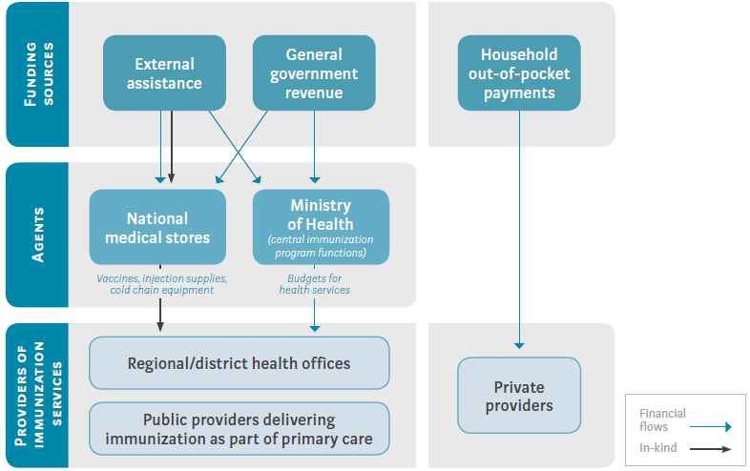
Primarily General Tax Financing &
Public Service Provision
Many low-income countries
Health systems financed through the government budget
Run by the MOH
Services delivered through network of public providers
Notes:
-Many low-income countries, and some middle- and high-income countries, have health systems that are financed through the government budget and run by the ministry of health,
--with services delivered through a network of public providers.
These systems, also known as national health services,
-typically provide centralized financial allocations to the health sector;
-the funds are then distributed downward to subnational levels.
-In more decentralized systems, local governments also contribute funding to the health sector and exercise greater control over resource allocation and decision-making.
In this arrangement, depicted in the figure, immunization financing comes almost entirely from general government revenues or donor contributions, with services delivered by public providers mainly at primary health care facilities.

Slide 142
Primarily General Tax Financing &
Public Service Provision
System known as “national health services”
Centralized vs. decentralized
typically provide centralized financial allocations to the health sector; the funds are then distributed downward to subnational levels.
In more decentralized systems, local governments also contribute funding to the health sector and exercise greater control over resource allocation and decision-making.
In this arrangement, depicted in the figure, immunization financing comes almost entirely from general government revenues or donor contributions, with services delivered by public providers mainly at primary health care facilities.
Notes:
-Many low-income countries, and some middle- and high-income countries, have health systems that are financed through the government budget and run by the ministry of health,
--with services delivered through a network of public providers.
These systems, also known as national health services,
-typically provide centralized financial allocations to the health sector;
-the funds are then distributed downward to subnational levels.
-In more decentralized systems, local governments also contribute funding to the health sector and exercise greater control over resource allocation and decision-making.
In this arrangement, depicted in the figure, immunization financing comes almost entirely from general government revenues or donor contributions, with services delivered by public providers mainly at primary health care facilities.

Slide 143
Primarily General Tax Financing &
Public Service Provision
Tax-based financing and public service provision systems
Some perform well (Malaysia and Sri Lanka)
Others have difficulty (characterized by chronic underfunding and staffing shortages)
A private sector often emerges to meet the demand
Typically poorly regulated
High OOP & weak financial protection
OOP: Out-of-pocket
Notes:
-Some health systems that rely on tax-based financing and public service provision perform well in general and achieve high immunization coverage rates. -Examples: Malaysia and Sri Lanka
-But many other countries that use the national health service model have difficulty securing adequate funds in the yearly budget process.
--These systems are often characterized by chronic underfunding and staffing shortages
A parallel, and typically poorly regulated, private sector often emerges to meet the demand for health services; together with the chronic underfunding of public facilities,
--this often leads to high out-of-pocket payments for patients and weak financial protection.

Slide 144
Primarily General Tax Financing &
Public Service Provision
Immunization financing may benefit from coherent policies and transparent budget allocations
Challenges
Underfunding
Staffing shortages in rural areas
Unclear division of responsibilities
Weak incentives
High OOP payments can limit access
OOP: Out-of-pocket
Notes:
In systems that rely primarily on tax-based financing and public service provision,
-immunization financing may benefit from coherent policies and transparent budget allocations at the national level.
-But potential challenges include:
--general underfunding of the health sector,
--staffing shortages in rural and remote areas,
--unclear division of responsibilities for immunization financing between national and subnational levels of government in more decentralized systems,
--and weak incentives at the health provider level.
--The high levels of out-of-pocket payments and reliance on private providers that often emerge for many health services can also affect access to immunization, although there is limited evidence of this globally.
(See Brief 8.)***

Slide 145
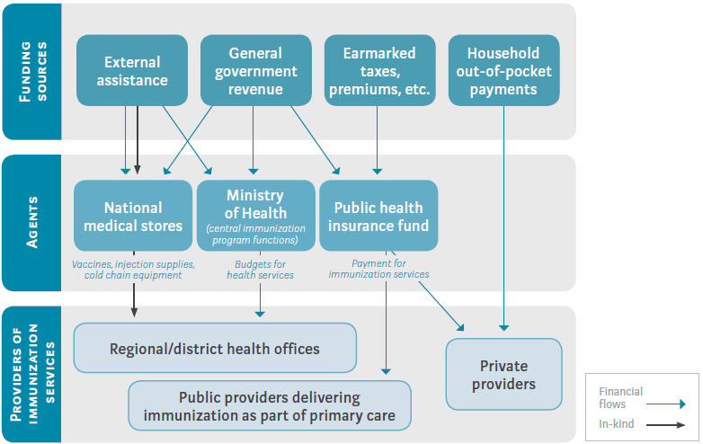
Mixed Public Financing &
Mixed Public-Private Service Provision
Some introduce public insurance systems (PHI)
Inject additional resources into the health system
Provide financial protection against OOP fees
Some introduce new arrangements between the purchasers of services & the providers
Public providers still typically receive MOH allocations
Opportunity to introduce new payment systems (RBF, others)
PHI system often increases financial protection for consumers
Funs flow is more flexible than traditional budget funds
OOP: Out-of-pocket, MOH: Ministry of health, RBF: Results based financing
Notes:
Some countries have introduced public insurance systems to inject additional resources into the health system and provide financial protection against out-of-pocket fees.
-Ex: Ghana, Indonesia, Peru, and Vietnam
These systems have also introduced new arrangements between the purchasers of services and the providers
-(although public providers still typically receive ministry of health allocations).
-These new purchasing arrangements can provide an opportunity to introduce new payment systems,
--including results based financing (RBF),
--and other strategic purchasing approaches.
These systems have increased financial protection for consumers in many cases, and funds that flow through insurance systems can often be used more flexibly than traditional budget funds.

Slide 146
Mixed Public Financing &
Mixed Public-Private Service Provision
As the national health insurance system (NHI) grows
Immunization coverage increases (in some countries)
But, can crowd out resources for immunization or other preventive services
Challenges (particularly with multiple insurance programs)
Extending insurance coverage to informal-sector workers
Achieving equity
OOP: Out-of-pocket, MOH: Ministry of health, RBF: Results based financing
Notes:
In some countries, immunization coverage has increased as the national health insurance system has grown.
-But expansion of an insurance program, particularly one that focuses on curative services, can crowd out resources for immunization and other preventive services.
Challenges arise in extending insurance coverage to informal-sector workers and achieving equity, particularly when the country has multiple insurance programs.

Slide 147
Mixed Public Financing &
Mixed Public-Private Service Provision
Health promotion and preventive services
Typically funded through MOH or NHI system
Financing and service delivery responsibilities must be clear
To prevent immunization from being neglected by the financing system and services providers, key:
Where services can be obtained
How services are covered
Cold chain supply & maintenance particularly vulnerable
NHI: national health insurance system, MOH: Ministry of health,
Notes:
Health promotion and preventive services, including immunization,
-typically continue to be funded through
the ministry of health budget, ---as in Ghana and Vietnam.
the national health insurance system, --- as in Indonesia, immunization is included in the benefits package of the NHI system
-Either way, countries should ensure that immunization financing and service delivery responsibilities are clear,
-And that people understand where immunization services can be obtained and how they are covered so immunization is not neglected by the financing system and service providers.
--Cold chain supply and maintenance can be particularly vulnerable in mixed systems with multiple institutional actors and unclear lines of responsibility.

Slide 148

Primarily Public Health Insurance Financing & Mixed Public-Private Service Provision
Some finance nearly all health services through a social health insurance system
Earmarked payroll
General tax funding
How the system works
Immunization services
Vaccine procurement
The MOH typically does not fund service provision
MOH: Ministry of Health typically
Notes:
Some countries finance nearly all health services through a social health insurance system funded primarily by
-an earmarked payroll tax (as in Estonia and Moldova),
-or with mainly general tax funding through a public purchasing agency (as in Thailand).
In these systems,
immunization services are
-- included in the benefits package
-- and providers are paid to deliver those services.
Vaccine procurement and other national functions are
--typically carried out by the ministry of health using budget funding,
---although in Thailand the purchasing agency is responsible for procuring vaccines and distributing them to health providers.
The Ministry of Health typically no longer funds service provision. (See the figure below.)

Slide 149
Primarily Public Health Insurance Financing & Mixed Public-Private Service Provision
Social health insurance systems (SHIS)
Clearly delineate functions
Creates opportunities to create incentives for health care providers
Risks for immunization functions
Some SHIS tie financial incentives to immunization coverage
Clarity in immunization functions → high immunization coverage rates
NHI: national health insurance system, MOH: Ministry of health,
Notes:
Social health insurance systems often clearly delineate functions within the health system, such as:
regulation, financing, and service provision.
This creates opportunities to use strategic purchasing and payment systems to create incentives for health care providers that are more comprehensive than in a mixed budget/insurance system. (??? Examples???)
But this approach comes with the risk that responsibilities for particular immunization functions may be unclear and payment incentives may disadvantage immunization services.
Some social health insurance schemes tie specific financial incentives to immunization coverage to ensure that immunization services are not neglected.
-For example, Estonia’s social health insurance system combines capitation payment for primary health care with a pay-for-performance program and additional financial incentives for achieving immunization coverage targets.
Social health insurance systems that clearly specify responsibilities for immunization functions across the MOH and the health insurance agency tend to achieve high immunization coverage rates.
--In Moldova, for example, the MOH has overall stewardship of the National Immunization Program, but the responsibilities of all cooperating agencies, including the National Health Insurance Fund as the payer of services, are clearly outlined in its comprehensive multi-year plan for immunization. This has resulted in a well-functioning program and high immunization coverage rates.

Slide 150
Key Challenge
  How to work with insurance and state mandates to do better planning and not duplicate
    Tuning into your country's task force
    Integrating vaccines with UHC and better planning

Slide 151
References & Resources
Part 1. Brief 2. pg 22-26. Results for Development (R4D). Immunization financing: a resource guide for advocates, policymakers, and program managers. Washington D.C.: R4D; 2017.
Ghebreyesus, T. A. All roads lead to universal health coverage. The Lancet Global Health, 5(9), e839-e840; 2017. http://dx.doi.org/10.1016/S2214-109X(17)30295-4
Loganathan, T., Jit, M., Hutubessy, R., Ng, C. W., Lee, W. S., & Verguet, S. Rotavirus vaccines contribute towards universal health coverage in a mixed public–private healthcare system. Tropical medicine & international health, 21(11), 1458-1467; 2016.
Bawa, S., McNab, C., Nkwogu, L., Braka, F., Obinya, E., Galway, M., ... & Ongwae, K. Achieving universal health coverage: implementation of a polio eradication intervention to deliver integrated primary health services to hard-to-reach and underserved communities in Nigeria Research. WHO Bulletin; 2018.

Slide 152
Section C2
Resource Tracking: Methods & Application

Slide 153
Section C2 - Resource Tracking:
Methods & Application
Sub-section learning objectives
Methods: Why track spending on immunization & data sources for tracking spending on immunization
  Purpose and uses of resource tracking for immunization
  Key definitions and framework
    Resource mapping, resource tracking, expenditure vs budget allocation; SHA, NASA
  Classify main resources used in immunization
    Capital and recurrent
  Sources of data
  Allocation of non-earmarked expenditures
Lecture accompanied by exercise
  Recap on System of Health Accounts (SHA) frameworks and coding
  Mapping of immunization spending to SHA classifications
  Examples & methodological notes

Slide 154
Lecture Overview
Interactive session, contextual reading and exercise
Identifying tracking factors for allocation of non-earmarked expenditures
Enter examples of government or development partner data into the EPIC Study Financial Mapping Data Collection Tool
Calculating future resources: base and incremental costs
Comparing budget allocations, actual expenditures and financing gaps
Country planning using choice of different financing modalities
Mapping donor architecture

Slide 155
Why track spending on immunization?
Know how much funding is allocated now and how much will be required for improvements
  New vaccines; delivery strategies; coverage
Know sources of financing for planning and documenting value for money
  Commitment of sufficient funding, efficient allocation and disbursement of that funding, efficient transitions between funding sources

Slide 156
Resource Tracking Specific policy questions?
  How much do a) governments & b) partners spend on:
    Vaccines?
    Routine Immunization (RI)?
  What % of total costs of RI are governments & partners paying?
  What % of health expenditure (government & total) is spent on RI ?
  What are trends and how do they fit with e.g. GAVI transition needs and new vaccine sustainability and coverage?
  Are funding commitments and disbursement matching needs & schedules?
  Where are current and potential bottlenecks in funding flows?
  What % of funding is spent on what EPI components, activities and items?
  What % of funds and other resources reach final beneficiaries?

Slide 157
Definitions
Resource tracking: Tracking sources and users, and magnitude of resources (financial, material, human, etc.) in both the health sector and immunization programs
Expenditure tracking: Tracking sources and users of financial resources in the health sector and immunization programs. Here the financial resources are the actual expenditure not the budget
Resource mapping: Mapping the flow of resources through various entities in the system.
Expenditure vs budget allocation: Expenditure is the total actual spending on program activities. Budget allocation is the finite amount of financial resources allocated to a program.
Financial bottleneck mapping: Identification of obstacles to financial flows: delays, leakages or reallocations.
Standardized and customized methods to fit priority questions and resource and time constraints
Notes:
Delays are the receipt of funds measured from the start of the fiscal year. Leakages are reductions in the actual funds received by districts and health facilities for routine immunization services when compared to planned or expected budgets. Reallocations include the deliberate shifting of budgeted funds actually received by districts and facilities from routine immunization budgets to other health services, such as outbreak response.

Slide 158
Resource Tracking Frameworks -
Methods and Tools in the Health Sector
Public Expenditure Tracking Surveys (PETS) – Focus on identifying delays in financial transfers and leakage rates. Not immunization specific
National Health Accounts (NHA) – Expenditure tracking
  Limited immunization details or ability to differentiate within Child Health
National AIDS Spending Assessment (NASA) – HIV specific
  Challenges to institutionalize
A multi-country study on costing and financing of routine immunization and new vaccines (EPIC 1) – More on the Expanded Programme on Immunization (EPI) details and coding within SHA system
Financial management systems
  Challenges of on- and off-budget funding; and limited definition of activities, output linkages
System Health Accounts (SHA) Framework

Slide 159
System Health Accounts (SHA) Framework
Boundaries for immunization in the SHA 2011 framework are governed by primary intent of an activity not the level or type of service provider
Global burden of disease classification: immunization is under prevention of communicable diseases
Five accounting dimensions:
  Healthcare financing schemes – government, “rest of world”, private
  Sources of funds for health sector – government and funding agencies
  Providers - entities that provide health care services and goods
  Functions - types of health care activities
  Capital formation in health systems
Health care provision categories (HR, pharmaceuticals, etc.)
Beneficiary categories (age, gender, socio-economic, geographic, etc.)
Notes:
As mentioned before,
-The System of Health Accounts (SHA) 2011 framework is an internationally recognized methodology that tracks all health spending in a given country over a defined period of time regardless of the entity or institution that financed and managed that spending.
-Helps generate consistent and comprehensive data on health spending in a country, which in turn can contribute to evidence-based policy-making in the country.

Slide 160
Resource Tracking Frameworks - Categories
Categories of activities
Distinguish Routine Immunization (RI) from Supplementary Immunization Activates (SIA)
  Key to issues of extending coverage, cost-effectiveness and affordability
Categories of resources used for immunization service purposes.
Recurrent Expenditures:
  Vaccines, Injection Supplies, Personnel, Utilities, Energy to Run Cold Chain, Transport, Fuel, Communications, In-service Training, Printing.
Capital Items:
  Cold Chain Equipment, Cold Rooms, Vehicles, Motorcycles, Incinerators Etc.
Shared Costs: Identify Shared Costs To Be Allocated Appropriately
  E.G. Shared MCH Program Costs; Cancer Awareness For HPV, Hep B

Slide 161
Sources of Data: Earmarked Spending
EPI managers are a good source for an overview of:
  How national and/or sub-national program is funded, expenditure and commitments
  Vaccination schedule
  Structure of the program
  Other
Secondary data on immunization expenditures:
  Government records, documents, accounts
  Development partner records: in-kind donations and finance*
    GAVI or UNICEF (procurement agency): value of donated vaccines
    WHO - technical assistance for surveillance and M&E
    Bill and Melinda Gates Foundation: information on immunization spend
    Country specific sources for immunization e.g. Local NGOs, foundations
Source: Dereje et al 2017
Notes:
Major donors for immunization programs include : Gavi, USAID, JICA, UNICEF (Program and Supply Division), WHO, BMGF, Rotary International, DfID, AusAid, Norad, Canada, and China

Slide 162
Sources of Data: Earmarked Spending
Activities | Possible Sources | Comments
Vaccine and injection supply procurement | EPI records; vaccine requisition & distribution; GAVI; UNICEF; other donors; manufacturers | Other donors may support vaccine purchases – e.g. for cholera vaccine
Service Delivery | EPI records (vaccine requisition & distribution); partner records Unit cost studies for details of activities and full costs | Possibly: GAVI HSS funding; USAID from Reaching every District (RED)
IEC/Social Mobilization | MoH Finance or EPI records; Partner records | Possible technical assistance (TA) from UNICEF and USAID RED
Training | EPI records; Development partner records | Technical assistance from WHO, USAID + other partners
Supervision | EPI records; Development partner records
M&E (incl. Surveillance) | EPI surveillance records; Partner records | Technical assistance from WHO + other partner records
Logistics | EPI and Partner records | For vehicle or motorcycle purchase, possible source is GAVI
Cold Chain Operation | EPI and Partner records | UNICEF if is procurement agency for cold chain; GAVI; JICA
Source: Adapted from Dereje et al 2017

Slide 163
Sources of Data: Non-Earmarked Spending
Sub-national data are often a major challenge, as are ‘non-earmarked expenditure’
Immunisation is part of other activities, not immunization or even activity/ program specific
‘Directly allocable” non-earmarked expenditures: part of immunization activities
  E.g . health worker salaries; operating costs of government health facilities (utilities, building maintenance, communications, etc); use of vehicle fleet
‘Non-directly allocable” non-earmarked expenditures: not directly part of immunization but facilitate provision of services
  E.g. general administration and management of the health sector.
  Country can opt out of allocating them to activities – just note in report
Use allocation/ tracing factors to allocate un-earmarked funds to different disease and priority health areas
  E.g. number of visits required for EPI regimen vs total PHC visits
Source: Dereje et al 2017
Notes:
Major donors for immunization programs include : Gavi, USAID, JICA, UNICEF (Program and Supply Division), WHO, BMGF, Rotary International, DfID, AusAid, Norad, Canada, and China

Slide 164
Allocation of Non-Earmarked Expenditure
Scenario 1: MoH spent $10 000 on vaccines for RI at health centers
Earmarked spending
Directly map expenditures to the health accounts categories
Scenario 2: MoH spent $20 000 on salaries of health center staff who provide immunization & other services
Non-earmarked but directly allocable
Distribute using allocation key developed by level, such as immunization visits as % of total outpatient visits, weighted for intensity of visits e.g. unit cost
Scenario 3: $100,000 on general administration of health system which includes immunization
Non-earmarked & non-directly allocable
If no unit cost other information e.g. time use by type of service, allocate according to # visits.
(convert # doses into # visits needed to administer those doses)
Distribute if an appropriate distribution key can be developed
or
Do not distribute by disease/priority area.
Source: Adapted from Dereje et al 2017. MOH: Ministry of Health. RI: Routine Immunization

Slide 165
Financing Bottlenecks
Limited number of studies but may be major factor in understanding flows, financing adequacy and EPI effectiveness. Bottlenecks in 3 main phases:
Budget elaboration: e.g. budget ceilings unlinked to EPI needs
Budget adoption: e.g. delays in donor processes and information on commitments
Budget execution: e.g. budget cuts or reprioritisation; delayed and partial disbursement to subnational levels; bureaucratic processes
Le Gargasson JB, Mibulumukini B, Gessner BD, Colombini A (2014) Budget process bottlenecks for immunization financing in the Democratic Republic of the Congo (DRC). Vaccine 32(9): 1036-1042.
Kabaniha G, Muheki Zikusooka C, Guthrie T (2014) Financing for immunization at sub-national levels: A systematic literature review . UNICEF New York

Slide 166
Challenges
Standardization:
  Immunization sub-accounts classification
  Data collection tools
  Financing bottleneck methodologies
Sub-national resource tracking : limited information and precedents
Accuracy of information – how much of a constraint on adequate EPI resource mobilization and progress?
Costs and delays in routine updates especially if actual expenditure tracked
Complementary costing study data: routine and SIA interventions

Slide 167
  MAPPING Expanded Programme on Immunization (EPI) Spending to the System of Health Accounts (SHA) Classification
Common Function (HC) categories that apply to immunization:
HC.6. Preventive care
Most common categories for preventive immunization spending are as follows:
  6.1 Information, Education and Counselling Programs
  Examples: mobilizing the community, advocating for vaccination, advertisements
  6.2 Immunisation programmes
  Include staff, vaccine costs, in-service training.
  Disaggregate spending into RI and SIA, and Facility based and outreach
  6.5 Epidemiological surveillance and risk and disease control programmes
  E.g. time & resources to follow-up post-vaccination events and cases of preventable diseases
HC.7. Governance and health systems financing administration
  Include if the activities directly attributable to improving immunization services.
  Examples: formulation of immunization-specific strategies and policies; immunization protocols; licensing; maintaining supply chain if in vaccine spending
Notes:
Examples of immunization spending for common categories in the Function, Provider and Factors of Provision classifications. Other categories are sometimes relevant.
See Excel Sheet “” Answer questions. Find HC.6 vs. HC.7.

Slide 168
    Using Health Accounts Data to
    Produce Immunization Indicators
Guided by Global Vaccine Action Plan (GVAP)
Key indicator: Domestic expenditure on immunization per person targeted to gauge country commitment
Suggests Joint Reporting Form (JRF)* data as a key source for monitoring and evaluation (M&E)
JRF key indicators for Routine Immunization (RI) financing (The government budget includes line items for spending in vaccines and associated activities for RI)
What is the total expenditure by government on vaccines used in RI?
What is the total expenditure from all sources on vaccines used in RI?
What is the total expenditure by government in RI (including vaccines)?
What is the total expenditure from all sources in RI (including vaccines)?
What is the share of government spend on vaccines out of the total spending in RI vaccines?
What is the share of government spending used in routine immunization out of total spending in RI?
*WHO-UNICEF, GVAP, 2013
Notes:
Find i. and vii. In excel sheet, understand how spending data is classified, and report value.

Slide 169
    Using Health Accounts Data to
    Produce Immunization Indicators
Guided by Global Vaccine Action Plan (GVAP)
Key indicator: Domestic expenditure on immunization per person targeted to gauge country commitment
Suggests Joint Reporting Form (JRF)* data as a key source for monitoring and evaluation (M&E)
JRF key indicators for Routine Immunization (RI) financing (The government budget includes line items for spending in vaccines and associated activities for RI)
What is the total expenditure by government on vaccines used in RI?
What is the total expenditure from all sources on vaccines used in RI?
What is the total expenditure by government in RI (including vaccines)?
What is the total expenditure from all sources in RI (including vaccines)?
What is the share of government spend on vaccines out of the total spending in RI vaccines?
What is the share of government spending used in routine immunization out of total spending in RI?
*WHO-UNICEF, GVAP, 2013
Notes:
Find i. and vii. In excel sheet, understand how spending data is classified, and report value.

Slide 170
    Using Health Accounts Data for Immunization Indicators
Joint Reporting Form (JRF) indicators continue…
Comprehensive approach to capturing spending in SHA 2011 allows it to be programmed to produce the JRF indicators.
Need customised SHA classifications:
  Capture spending on RI and SIA separately
  Capture vaccines spending separately under factors of provision (input) dimension pharmaceuticals classification;
  Tease out the immunization earmarked spending
  The “SHA-JRF cross-walk”
Notes:
See last Excel Sheet

Slide 171
Cross-walk between SHA and JRF
‘X’s are indicators for use to cross-walk between SHA 2011 and the financing indicators of the JRF
 |  | JRF Indicators
 | CURRENT HEALTH SPENDING | Govt spending on vaccines | Total spending on Vaccines | Government Spending RI | Total Spending on Immunization
SHA 2011 Framework
 | Source
 | FS.RI.1 Government | X | X | X | X (map only portions fully allotted to RI)
 | FS.RI.2 Corporations |  | X
 | FS.RI.3 Households |  | X
 | FS.RI.4 NGOs |  | X
 | FS.RI.5 Donors |  | X
 | Function (only relevant to RI)
 | HC.6 Preventive Care |  |  | X (only portions fully allotted to RI) | X (only portions fully allotted to RI)
 | HC.6.1 IEC programs
 | HC.6.2 Immunization programs
 | HC.7 Governance & health system admin
 | Input
 | FP.1 Compensation of employees (only portions fully allotted to RI |  |  | X | X
 | FP.3 Materials & Services used
 | FP.3.2 Health care goods
 | FP.3.2.1 Pharmaceuticals | X (create & track | X sub-categories | X for RI vaccines) | X
 | FP.3.2.2 Other Health care goods |  | (create & track | X sub-categories | X for RI vaccines)
 | Disease/Condition
 | Vaccine preventable Diseases |  |  | X | X
Notes:
SEE exercise.

Slide 172
Resource Tracking Framework – Application
Read Country ‘X’ Case Study and data and answer the questions
This case study and questions will help understand:
System of Health Accounts (SHA) frameworks and coding
Mapping of immunization spending to SHA classifications
Examples & methodological notes
  Use of resource tracking information to generate GVAP and UNICEF-WHO Joint Reporting Form indicators
  Anticipate and resolve some challenges e.g. expenditure vs disbursement vs commitment data
  Understand possible adaptations to SHA methodology for EPI planning needs
  Ability to use resource tracking information to address key health policy questions
Source: https://www.who.int/health-accounts/en/

Slide 173
Other Examples
Using Data from Uganda

Slide 174
    Results from Uganda
Financial Mapping rather than Resource Tracking
  Commitments not disbursements not expenditures
  Challenges confirming commitments were disbursed or expended in specific years
Based on SHA 2011 classifications
  With more detailed sub-coding within immunisation - for standardization, cross-country comparison and compatibility with NHA data sets
Limited ability to track down to service level.
Costing study unit costs used to estimate resources at each level
Not actual fund movement to lower levels, but consumption of goods, services, salaries.
  So cant assume that the $10 from FS went to FA and then down to HP (though HR and vaccine costs at service level quite well known)
Source: Guthrie, Zikusooka, Kwesiga, Kinghorn et al (2014) Study of Financing & Costing of Routine Immunization Programs and new Vaccine Introduction In Uganda. Final Technical report

Slide 175
Main Financing Sources for EPI 2009/10-2010/11 (USD, %)
Notes:
Blue = internal govt transfers for national public spending.
Maybe note that the one GAVI disbursement came late in 2010/11 so might have only been spent in the following year (a resource tracking would capture it in the following year)
Red for public transfers to districts and facilities, including salaries estimated in costing study
Govt total = almost 60% in 2009/10, 42% in 2010/11.
GAVI next greatest contributor.
USAID cold rooms in 2009/10
JICA fridges in 2011/12 in PCV prep

Slide 176
Health Care Financing (Agents) of Immunization Funds in Uganda
(2009/10 & 2010/11, US$)
Notes:
Bulk of the funds and commodities being managed by NMS and MOH

Slide 177
Health Providers of Immunization Services in Uganda (2009/10&2010/11, US$, %)
Notes:
Most services delivered through public entities – 99.9% Note the mapping may not have disaggregated all spending going to NGOs – which deliver services on behalf of govt. Note the increase in facility level consumption was the JICA spending on CC equipment.

Slide 178
Funding flows to Immunization Activities
(2009/10&2010/11, US$, %)

Slide 179
Immunization Spending by Line-items (2009/10&2010/11, US$, %)
JICA supported Cold Chain Equipment in 2010/11, USAID in 2009/10

Slide 180
Conclusions:
Financing of the Uganda EPI
The largest contribution to the programme from GoU (56% in 2009/10; 42% in 2010/11)
  generally underestimated previously
  the bulk of public funds went to salaries and co-payment under GAVI agreement
Next largest contributor was GAVI (33% & 38%) for vaccines
Valuable, catalytic contributions from other partners
  Some smaller sources were identified (not known at the beginning of the study)
Overall total amounts anticipated in the country multi-year planning tool (cMYP) were close to those found by the mapping for 2011
Notes:
Accurate sub-national tracking (to asses fund re-allocations & diversions) plus recording/transmitting fund flow delays +wastage all are critical for assessing sustainability of achieving RI targets .
we clarifying costs to deliver equitable/universal immunization or costing inefficient and inequitable existing systems. Does this help us decide where alternative delivery mechanisms might be a better investment than simply scaling up the service provision platform(s) currently used.

Slide 181
Implications -Financing of the EPI
Sustainability of the Uganda EPI (esp. with new vaccines) will require ongoing contributions from GoU and partners:
  Need to assess fiscal space for GOU to contribute a larger share
  Degree of donor vulnerability/ uncertainty?
Ongoing routine tracking of financial flows (multi-year trend data), estimation of resource needs with financial gap analysis needed:
  Track by activity/ intervention – including SIAs
  Identify delays, bottlenecks and need for/ effects of fund re-allocations/ diversions/ delays
  Improve public financing system to better code & collate expenditures
  Improve accounting and transparency around actual expenditures and potential efficiency gains
  Mobilise resources (domestic and international)
Notes:
NUVI estimates could add between 40% to 60% of current routine immunization costs (for 60% to 90% coverage of PCV)

Slide 182
Summary of Key Points
Resource tracking or mapping a useful tool for policy, strategic and financial planning, and accountability
Can provide data for key indicators and plans e.g. cMYP
Gives useful inputs into dialogue on sustainability, co-financing and GAVI transitions
SHA system needs elaboration to respond to EPI needs – useful precedents available
Notes:
NUVI estimates could add between 40% to 60% of current routine immunization costs (for 60% to 90% coverage of PCV)

Slide 183
References & Resources
Dereje et al/Abt Associates. (2018). Tracking Immunization Spending Using SHA 2011. (Draft Document). In WHO Guidelines for Approaching Disease/Priority Health Area Expenditure in System of Health Accounts 2011.
Notes:
Kabaniha G, Muheki Zikusooka C, Guthrie T (2014) Financing for immunization at sub-national levels: A systematic literature review . UNICEF New York

Slide 184
Section D
Using Financial Analysis for Policy Change

Slide 185
Section D - Using Financial Analysis for Policy Change
Learning Objectives
Strategies for policy change
  How to be a good policy change advocate, looking for funds and drive off the competition
  Building parliamentary support for immunization financing
  Immunization financing legislature and regulation
Immunization planning and budget cycle
  Fiscal space & budgeting
  Fiscal gap calculation

Slide 186
Section D1
Strategies for Policy Change

Slide 187
Building parliamentary support for immunization financing
MOH and MOF implement relevant policies but national parliaments also play a crucial role
National parliaments
  Legislative power
  Power to direct flow of public funding to public projects
Types of legislation related to immunization programs
  Mandates the introduction of new vaccines
  Approve and amend the budgets
  Establish financing mechanisms for immunization services
  Oversee the implementation of new immunization-related policies
MOH: Ministries Of Health, MOF: Ministries Of Finance
Notes:
Overview

Slide 188
How do parliamentary functions affect immunization financing?
4 main functions:
Lawmaking/legislating (leaders, opposition parties, senior members)
  Set the agenda
  Assign bills to committees
  Rally support to legislative initiatives
  Nepal’s Kathmandu Declaration (endorsed by parliamentarians)
    Voiced a commitment to working for sustainable immunization financing
    Then, the government drafted an immunization bill
    In 2016 the parliament passed Immunization Act 2072
    The president of Nepal signed it into law
Budgeting
  The executive branch typically proposes the budget, but parliament approves it
  The budget for the MOH includes (in most countries) a line item for vaccines
Notes:
Details

Slide 189
How do parliamentary functions affect immunization financing?
Oversight
  Parliament oversees and monitors executive branch actions (compliance in the use of resources) - Through the annual budget process:
    Regular check on the executive’s power
    Involves review by multiple committees and members of parliament. Committees:
      Hold hearings and call expert witnesses to provide testimony (on operations & policy)
      Provide immunization advocates with an opportunity to press for sustainable immunization financing
  Relationship between parliament and the executive branch varies
Representation
  Members of parliament: representatives of the people / constituents
    Advocate for constituents interests (in parliament and committees)
    Advocates for immunization can therefore influence parliament by mobilizing local constituencies
Notes:
Details:
Relationship: some parliaments have significant capacity to check the powers of the executive, while others have less authority to direct and oversee executive action.

Slide 190
How can immunization advocates engage effectively with parliaments to build support for sustainable immunization financing?

Slide 191
Strategic Entry Points for
Working with Parliaments
Parliamentary structures vary but there are a few discrete actors within the parliamentary process that are most influential in determining immunization financing agendas
Parliamentary leaders
  Set the legislative agenda
  Assign bills to particular committees
  Rally support for legislative initiatives
Committees
  Members and leaders
  Support staff (staff attached to members, committees, and nonpartisan secretariats) can play an important role behind the scenes
    Review legislation related to public immunization services
    Ensure consistency with existing national and international legal frameworks
    Evaluate the government’s performance in implementing new laws

Slide 192
Strategic Entry Points for
Working with Parliaments
Specific committees
  Key issue advocates: Standing committees on finance & appropriations
    Review all requests for government spending
    Without their approval - a spending bill is unlikely to be adopted by parliament
  Health committees: consider immunization programs and budgets
Secretariat staff
  Ensure that members of parliament have the information needed to make informed legislative decisions
  Help arrange committee meetings and hearings
  Advocates:
    Can ensure that secretariat staff are copied on all communications to committees & parliament
    Can maintain contacts with parliamentary library, research, and documentation staff (to ensure access to relevant documents and info. related to immunization programs and financing)
This is a national level focus, but much of service delivery financing in India, Pakistan is at the state level-- who do stakeholders engage with at the state level and how?
Notes:
This is a national level focus, but much of service delivery financing in India, Pakistan is at the state level-- who do they engage with at the state level and how? Would be a good question to ask participants?

Slide 193
Strategic Entry Points for
Working with Parliaments
Influential members of parliament
  Well-regarded, charismatic, or effective members of parliament can be influential without holding positions of seniority within the formal parliamentary structure
  Champions for particular issues and collaborate with advocates
New members of parliament
  Engage them early on issues of immunization and immunization financing -- they can become active champions
Other: International unions of parliaments
  Can be influential in shaping and determining regional agendas/policies
  Ex: “the Latin American Parliament” (a consultative assembly) generated a Model Vaccine Law
    Provides a framework for countries to ensure adequate and effective access, and financing, to national immunization services

Slide 194
Key Messages to Parliaments on Immunization Financing?
Major issues, challenges, and opportunities
Vaccines - among the most powerful and effective public health interventions ever developed!
GOOD VALUE and 1 of the best uses of limited public resources for health
$1 invested in immunization --> $16 in returns for the broader economy
Governments must plan carefully to ensure sustainable financing
Failure → increase risk of disease outbreaks
Parliamentarians’ key questions:
Current performance
What does the future of the immunization program look like?
Is the immunization program adequately funded?
Other bottlenecks?
Strong immunization program depend on 1) funding & 2) adequate financing of local level health workers and facilities (providers)
Notes:
1. Performance Qs:
What are the coverage rates for vaccines in the national schedule,
how equitable is coverage,
how do they compare to targets?
What vaccines are in the national schedule compared to WHO’s recommended schedule?
Look like
Will coverage change over time?
Are new vaccines likely to be introduced?
3. Adequately funded?
Are vaccine budgets adequate?
Are investments in the cold chain suitable?
4. Financing is only one part of the picture,
what other bottlenecks impeding program
performance
How might they be addressed?

Slide 195
Efforts to Engage Parliamentarians on Immunization Financing
Many organizations have already actively engaged with parliamentarians
UNICEF, the World Bank, World Health Org., Sabin Vaccine Institute
  Ex: The Sabin Vaccine Institute - provides technical and legislative guidance on promoting and protecting immunization financing
  Contributed to the launch of legislative initiatives in several SIF countries

Slide 196
Immunization Financing
Legislature and Regulation
Legislation can provide a legal framework for the operation of immunization programs
  How vaccines are added to the national immunization schedule
  Who has regulatory oversight
Explicit legislation can help clarify legal frameworks for the procurement of vaccines and injection supplies
  Ex: Latin America
  Some restrict payment in advance of delivery --> makes it difficult for ministries to procure vaccines through UNICEF Supply Division
Immunization legislation varies across countries
  Vietnam: “Law on Prevention & Control of Infectious Diseases” guarantees funds
  Bolivia: Law on Vaccines - mandates a specific share of earmarked funds for health go toward vaccines and operational costs
  Others:
    Georgia: Public Health Law - require the financing of vaccines in the national immunization schedule
    Panama: Law 48 – enshrines access to vaccines in the national immunization schedule / a legal right

Slide 197
Most Common Provisions In Immunization Legislation Fall into 3 Categories
Declarative: establish legal rights and duties relating to access to immunization
  Mandates for universal access to immunization for all citizens
  Adoption of legislation recognizing immunization as a public good
  Legislation establishing a legal duty to vaccinate and call for mandatory vaccination for adults and children (e.g. shool enrollment)
  Establishment of clauses guaranteeing free and universal access to vaccines in the national immunization schedule
Notes:
Promoting sustainable immunization financing through legislative action

Slide 198
Most Common Provisions In Immunization Legislation Fall into 3 Categories
Operational: provide a legal framework for public health authorities relating to immunization
  Establish regulatory oversight of immunization programs to ensure that vaccines are administered in accordance with legislative directive.
  Require a legally chartered national immunization technical advisory group (NITAG).
  In countries with mandatory vaccination, operational provisions may set legal penalties for individuals who fail to comply.
Immunization legislation often includes an operational provision ➔ usually defines the process
Notes:
Defines the process:
by which vaccines are introduced and removed from the schedule, who makes the decision, what the decision-making criteria are, who has oversight over the decision making process, and so on. These elements are critical for both routine vaccine delivery and the financial needs of national immunization programs

Slide 199
Most Common Provisions In Immunization Legislation Fall into 3 Categories
Financial: establish the legal framework for immunization financing
  Establish explicit line items within the national budget for the procurement of vaccines and for other elements of the immunization program
  Identify the procurement mechanisms that must be used;
  Guarantee tax exemptions for the purchase and importation of immunization materials (including vaccines and cold chain equipment) establish the sources of immunization financing
Many countries adopt legislation declaring that the government must pay for immunization, but immunization laws typically do not define the mechanism by which immunization should be financed

Slide 200
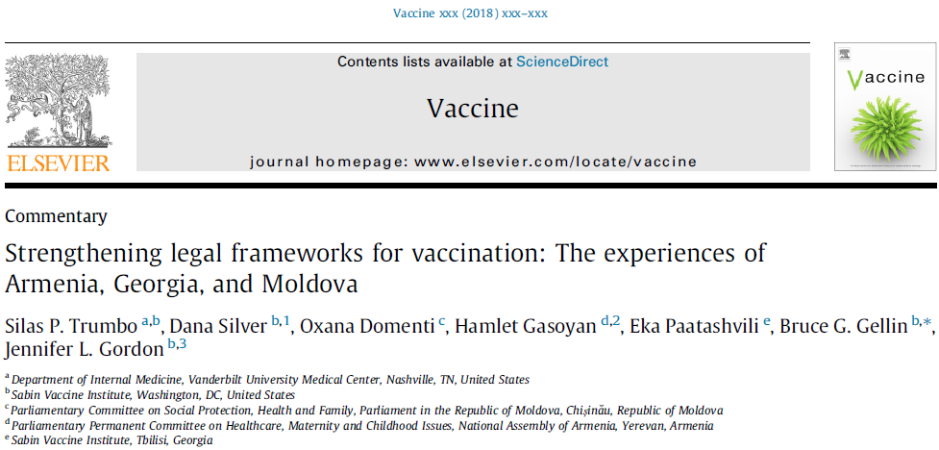
Experiences of 3 Countries Strengthen their Legal Frameworks
For details about the content of vaccination legislation in low- and middle-income countries and the processes by which countries strengthen their legal frameworks see:
All Gavi supported countries

Slide 201
How to be a Good Policy Change Advocate
Tune in to priorities of UHC task force and planning
  Integrate vaccines with UHC and insurance
  Fiscal space for UHC is fiscal space for vaccines
Work on vaccine mandates and statements of rights
Notes:
Tune into your country's task force, don't duplicate. Integrate vacc with UHC, the money they find is what you can work with too, do better planning, how to work with insurance and state mandates, UHC principals (mixed fin.)

Slide 202
Summary of Key Points
Immunization advocates should engage key actors in parliaments, including:
  Parliamentary leaders
  Standing and ad hoc committees
  Secretariat staff
When engaging with policymakers, advocates should be prepared to discuss the performance of the country’s immunization program, including:
  Its challenges and
  Its present and anticipated resource needs
See the key points presented in each brief in the R4D 2017 Resource Guide as primers for parliamentarians on critical issues related to immunization financing

Slide 203
Summary of Key Points
Immunization advocates consider legislation to be a powerful tool in support of sustainable immunization financing because it provides:
  A legal commitment to immunization and
  An operational framework for immunization services
Legislation can be effective only if it is enforced and implemented by the government
Immunization legislation frequently includes three types of legal provisions:
  Operational
  Declarative
  Financial

Slide 204
References & Resources
Part 1. Brief 15-16., Results for Development (R4D). Immunization financing: a resource guide for advocates, policymakers, and program managers. Washington D.C.: R4D; 2017.
Trumbo SP et al. Strengthening legal frameworks for vaccination: The experiences of Armenia, Georgia, and Moldova. Vaccine (2018), https://doi.org/10.1016/j.vaccine.2018.10.069
Sabin Vaccine Institute [Internet]. Legislation. Available from: http://www.sabin.org/programs/sif/legislation
Ozawa S, Clark S, Portnoy A, et al. Return on investment from childhood immunization in low- and middle-income countries, 2011–20. Health Affairs. 2016 Feb 1;35(2):199-207.
Advocacy for Immunization [Internet]. PATH, IVAC, and Gavi resources to assist in advocacy for immunization. Available from: http://advocacy.vaccineswork.org/

Slide 205
Section D2
Planning and Budget Cycle

Slide 206
The Budget Cycle
Every government follows a budget cycle (4 Phases)
  Policy-based revenue projection
  Budget formulation
  Budget execution
  Monitoring
Budget planning tools and processes for the health sector
  Often not well integrated into the budget cycle → misaligned processes or unavailable funding
  Consequences can be severe → hamper immunization efforts & UHC
Understanding a country’s budget cycle is important for effective immunization advocacy and planning
  UHC: Universal health coverage

Slide 207
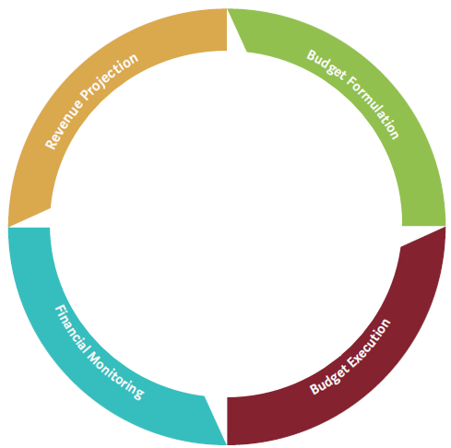
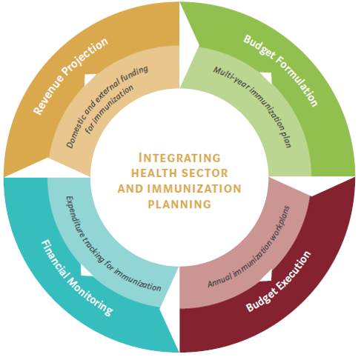
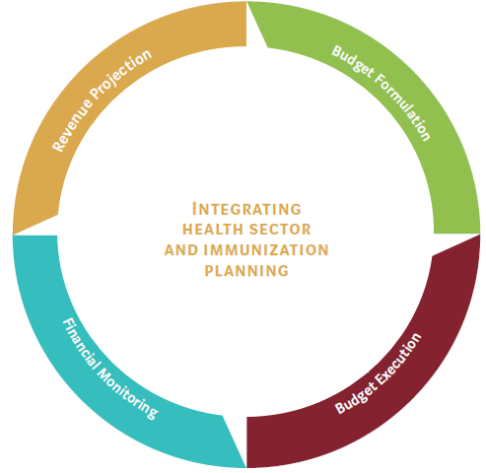
The Budget Cycle
Opportunities to Integrate Immunization Planning into the Budget Cycle
Figure source: R4D 2018, adapted from WHO-UNICEF Guidelines for cMYP for Immunization (September 2013)

Slide 208
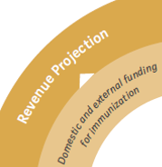
The budget cycle starts with revenue projection
The ministry of finance determines level of overall expenditure
  The better a government is at projecting revenue across sources (e.g. across different streams of “on-budget” revenue) the more credible
Countries with high donor funding
  May have “off-budget” streams for immunization and other services
  Off-budget streams: go directly from a donor → to an implementing partner and skip government accounting systems
    Can lead to budget fragmentation and lack of transparency --> reduce the government’s ability to identify where limited public funds can have the most impact
Getting a clear fiscal picture and determining realistic health spending levels
  Critically important: Get full estimate of potential on- and off-budget external funding for immunization (along with other health revenue streams)

Slide 209
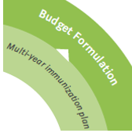
Phase 2: Funds are negotiated, reviewed, approved, and allocated across line agencies
Much of the work is conducted through the parliament's permanent or ad hoc committees (most countries)
Key targets for advocacy for immunization funds
    Standing committees on finance and appropriations review all requests for government spending
    Health committees consider immunization programs and budgets
    Individual parliamentarians who advocate for particular issues both within and outside of committees
Consultative phase “bottom-up planning”: Subnational governments provide evidence-based indications of needs
    if this phase is well coordinated --> important entry point for advocates
    If not well coordinated --> immunization advocates might push for better accountability or consultation mechanisms
Notes:
Funds are negotiated (with line agencies)
Reviewed (by the cabinet or another body)
Approved (by the parliament or other body)
Allocated across line agencies (by the ministry of finance or the treasury)
Budget negotiations often include a consultative phase

Slide 210
Phase 2: Funds are negotiated, reviewed, approved, and allocated across line agencies
The overall budget framework and national budget law partly dictate how ministries allocate funds
Rigid rules → constrain the MOH to pool and redistribute according to need & to strategic purchasing of vaccines and services
To aid planning → have a multi-year planning process
  A medium-term expenditure framework (MTEF)
  Can aids the MOH budget to project across a number of years
    If the MOH budget grows over time - helps create fiscal space for immunization financing from domestic sources
    If the budget remains flat or declines - helps plan for resources for a growing immunization program to come from efficiency gains, reallocations within the health budget, or new external financing
MOH: ministry of health
Notes:
Funds are negotiated (with line agencies)
Reviewed (by the cabinet or another body)
Approved (by the parliament or other body)
Allocated across line agencies (by the ministry of finance or the treasury)
Budget negotiations often include a consultative phase
Rigid rules example:
the budget might have a line item for vaccines that does not reflect actual levels of need,
or a program budget might include particular outcome or output indicators for defined program areas that are misaligned with program goals.

Slide 211
Medium-Term Expenditure Frameworks (MTEF)
Sophisticated approach to planning and budgeting
  Developed in the early 1980s, by 2008 adopted by 2/3+ of all countries
  Help policymakers align government priorities with what they can afford by creating multi-year plans, typically covering 3 to 5 years
  Enable transparent allocation of public resources against strategic priorities → create an activity- and output-based orientation
Include
  Macroeconomic and fiscal targets
  Projections of the resource envelope to help establish expenditure ceilings for sectors and agencies --> guide bottom-up planning
  Expenditure allocations
    Can be set at the spending agency level or more comprehensive
    Ex: Ghana’s MTEF - includes immunization coverage as an output indicator
Understanding of immunization costs at the budgeting and planning phase can help advocates to integrate immunization into the MTEF, program budgets, and other key planning processes
  Pooling and redistribution planning decisions, vaccine procurement, and strategic purchasing for services
Notes:
Problems
a national health strategy or plan may function only as a laundry list of activities and may lack cost information that can help guide implementation.
In addition, disease-specific plans that are not linked to the national strategy may proliferate in isolation across technical areas (including immunization)
Without this kind of comprehensive, multi-year planning process, budgeting problems can occur
Separate plans may not be linked in any specific way to the budget formulation or costing process (merely a laundry list)
If cost data is not available (or only historical values) – difficult for immunization advocates to win support for emerging needs & long-term planning
health sector strategic planning decisions that inform pooling and redistribution according to need, vaccine procurement, and strategic purchasing for services

Slide 212
Comprehensive multi-year plan (cMYP)
cMYP is a tool that can help with integrated health and fiscal planning
  Launched in 2006 by WHO and UNICEF
  Immunization-specific planning tool that encompasses immunization planning, costing, and financing (not a budgeting tool)
Creating a cMYP (several phases)
    Developing a situation analysis
    determining specific activities, milestones, and strategies
    identifying links to national, regional, and international goals
    Preparing activity timelines and monitoring and evaluation plans
    Estimating immunization-specific costs (such as for vaccines, injection supplies, and full-time staff )
    Identifying financing sources
Effective cMYPs → rely on government consultation and collaboration with civil society, partners, and the private sector
    Updated annually
    When accurate can be used to advance the budget process and promote dialogue between the
    MOH and MOF
MOH: ministry of health, MOF: the ministry of finance
Notes:
highlight both what the tool does and doesn't do. For instance, IT DOESN'T REALLY HELP WITH PLANNING INCREMENTAL DELIVERY COSTS OF NEW VACCINES, OR INCREMENTAL COSTS OF ACHIEVING HIGHER COVERAGE. NOTIONAL AT BEST ON THESE.
is not a budgeting tool.

Slide 213
Other Tools
The World Health Organization (WHO) website offers several other tools
  Forecasting vaccine requirements and determining the need for injection supplies, logistics, and cold chain equipment and supplies
  Maintains a database of cMYPs
The Pan American Health Organization (PAHO)
  Offers an Immunization Toolkit with an Annual Plan of Action (inform the guidelines for cMYPs)
  Provides resources on vaccine forecasting, supply chain sizing, and logistics forecasting; a cold chain volume calculator; and a vaccine presentation assessment
MOH: ministry of health, MOF: the ministry of finance

Slide 214
Budget Formulation
Projections of GHE, GE, etc? Data sources, etc

Slide 215
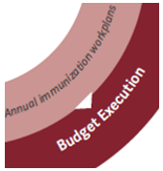
Phase 3: Budget Execution
Public financial management systems should support efficient disbursement, receipt, and use of funds by cost centers
  Purchase immunization services and commodities (including vaccines and cold chain equipment and supplies)
  Fund costs related to service delivery
Allocation occurs according to health needs and through line-item
  Input-oriented payment systems (payment according to materials needed to produce an output) or
  Output-oriented payment systems (payment according to what is produced rather than used)
Governments may face challenges with transferring funds on time or in full
    Ex: Republic of the Congo - disbursement delays and commitment shortfalls from the state budget contributed to vaccine shortages
    A program might be sufficiently funded at the national level but have difficulty getting funds to facilities due to poor systems, weak accounting, or corruption and leakage
    Rigidities in the public financial management system - prevent use of strategic purchasing that promotes quality immunization service delivery or rational procurement.
    Decentralized countries - may face issues in managing budgets and coordinating procurement across levels
Notes:
To address issues: policymakers in the MOH should work to align annual immunization work plans with annual health sector and individual program work plans

Slide 216
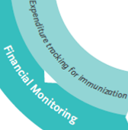
Phase 4: Budget Monitoring
Policymakers and advocates need to understand how money is being spent → ensure accountability, efficiency, equity & inform spending decisions
MOH can help by:
  Tracking funding flows
  Linking funds to expenditures on services produced or inputs purchased
    Vaccines, cold chain supplies, etc.
  Use internal audits (or other measures)
Output-based mechanisms can create incentives for MOH to track immunization-related results & inputs purchased
  MTEF and program-based budgeting
  Crucial to disentangling the causes and effects of underspending
Notes:
Underspending:
Might be the positive result of system efficiencies that make existing funds go further,
Or it might result from
poor financial management,
limited capacity on the part of units that receive funds to spend those funds,
late disbursement,
or inadequate capacity to track and account for expenditures.

Slide 217
Phase 4: Budget Monitoring
Underspending
The positive result of system efficiencies that make existing funds go further
Result from
  poor financial management,
  limited capacity on the part of units that receive funds to spend those funds,
  late disbursement,
  or inadequate capacity to track and account for expenditures.
Challenges
If responsibility for implementing programs is fragmented
If the program components themselves (e.g. immunization and maternal and child health) are not integrated
  Tracking of immunization spending should be integrated into general accounting and accountability measures to provide a holistic view of expenditures

Slide 218
Summary of Key Points
Domestic public funding is the most important source of immunization financing
  Immunization planning and financing must be considered as a part of the broader budget process.
Understanding budget cycles and processes is crucial to finding opportunities and mitigating financial risks for immunization efforts.
Existing planning tools can help with estimating costs, identifying sources of financing and resource gaps, and formulating arguments in favor of immunization investments
Standalone planning for immunization disconnected from the national budget can lead to fragmentation and budgeting problems and make it difficult to win support for immunization goals and build integrated processes

Slide 219
References & Resources
Ozawa, S., Grewal, S., Portnoy, A., Sinha, A., Arilotta, R., Stack, M. L., & Brenzel, L. (2016). Funding gap for immunization across 94 low-and middle-income countries. Vaccine, 34(50), 6408-6416. http://dx.doi.org/10.1016/j.vaccine.2016.09.036
Barroy, Helene, et al. Assessing fiscal space for health expansion in low-and-middle income countries: a review of the evidence. No. WHO/HIS/HGF/HFWorkingPaper/16.3. World Health Organization, 2016.
Allen R, Hemming R, Potter BH. International handbook on public financial management. New York: Palgrave Macmillan; 2016.

